Slide 1

ACCL23-12 Interview
Presenter: Eric Viklund

Slide 2
Personal Introduction
Name: Eric Viklund
Contact:
ericviklund2023@u.northwestern.edu
+1(860)834-5008
Education:
B.S. Physics from University of Connecticut
Currently PhD candidate at Northwestern University
Research Experience:
SRF Cavity Manufacturing Technology
Electropolishing
Mechanical Polishing
Nb₃Sn Cavity Manufacturing via Tin Vapor Diffusion
Surface Analysis
Scanning and Tunneling Electron Beam Microscopy
Focused Ion Beam Milling for Sample Preparation and 3D Imaging

Slide 3
Outline
Research Experience
Study on the Electrochemical Polishing Process Applied to Niobium SRF Cavities
Development of a Mechanical Polishing Process for Nb₃Sn Coated SRF Cavities
Research Proposal
Cost Reduction Methods for Niobium SRF Cavity Fabrication
Study on the Mechanical Properties of Large Grain Niobium and the Deep Drawing Fabrication Method
Study on the HF-Free Bipolar Electrochemical Polishing Method

Slide 4
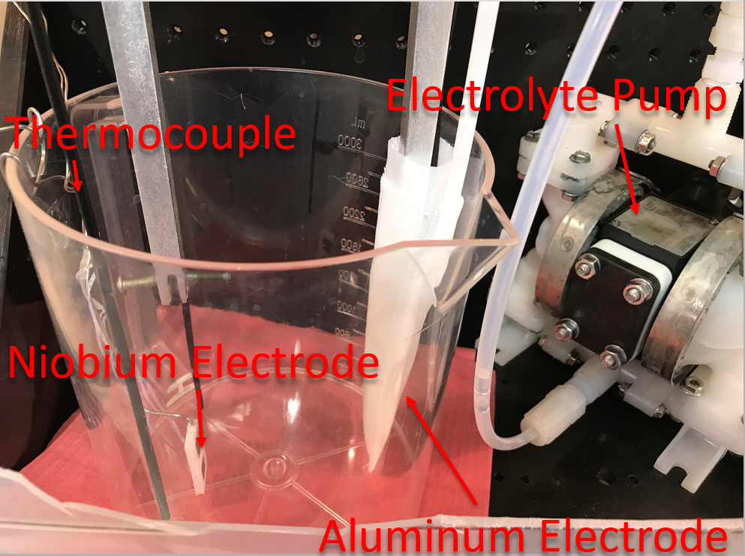
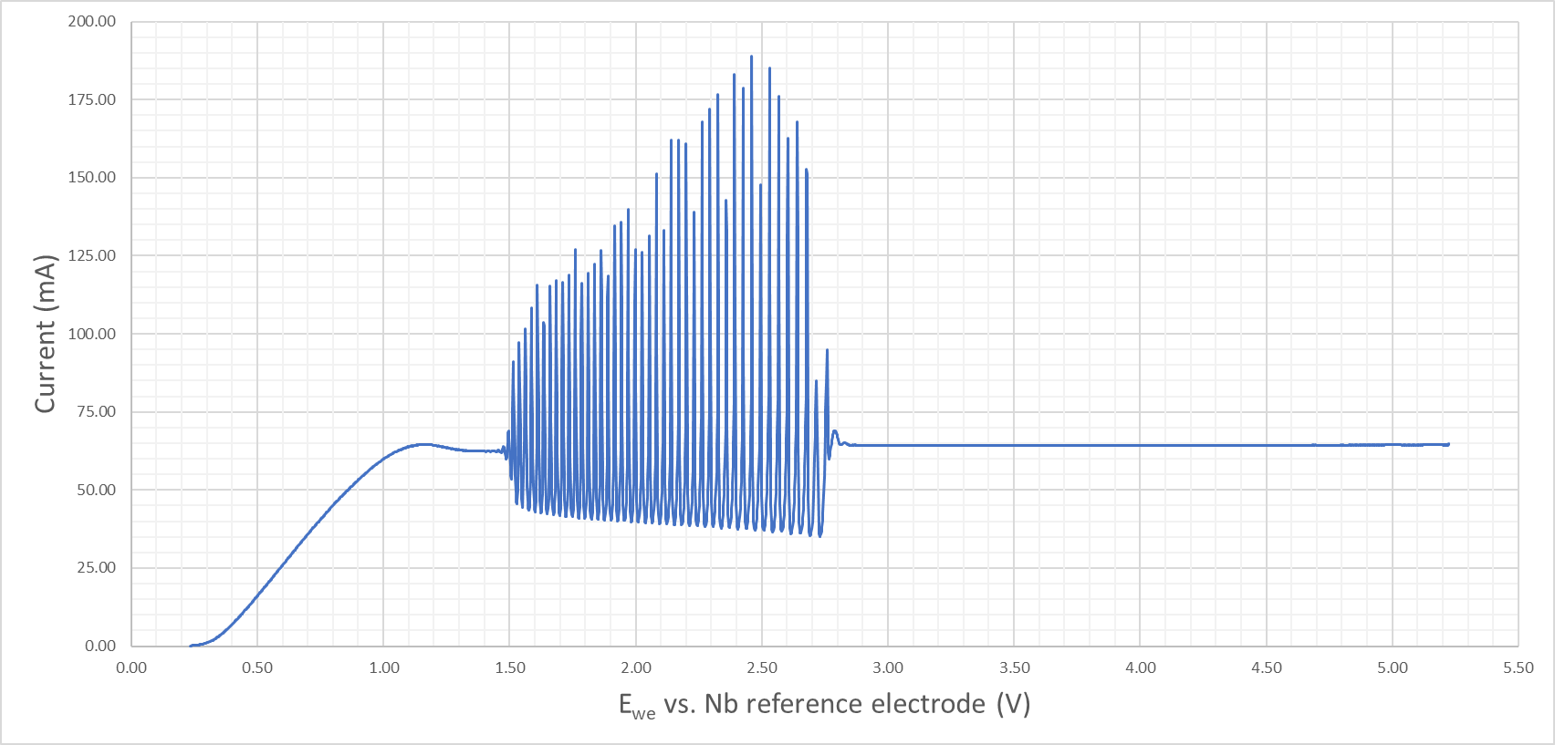
Electropolishing Study
Defects such as etching and pitting were discovered in nitrogen doped niobium cavities.
It was determined that a better understanding of EP was necessary to understand and prevent these defects.
Niobium samples are electropolished using different parameters.
Applied voltage
Electrolyte temperature
Nitrogen doping

Slide 5
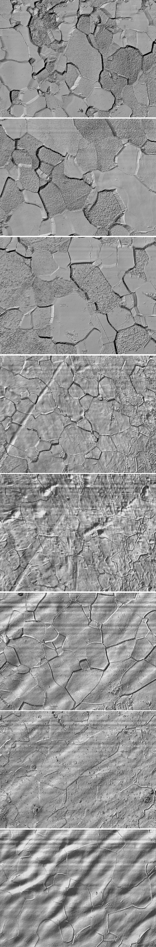
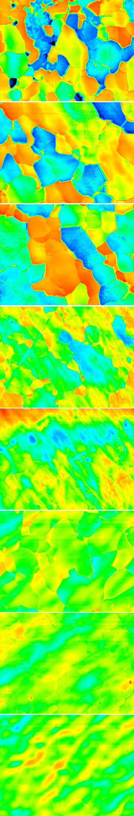
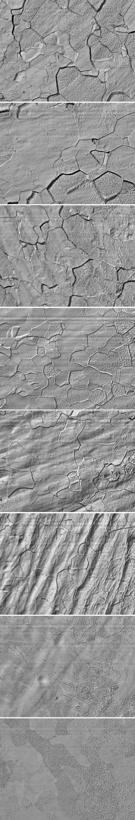
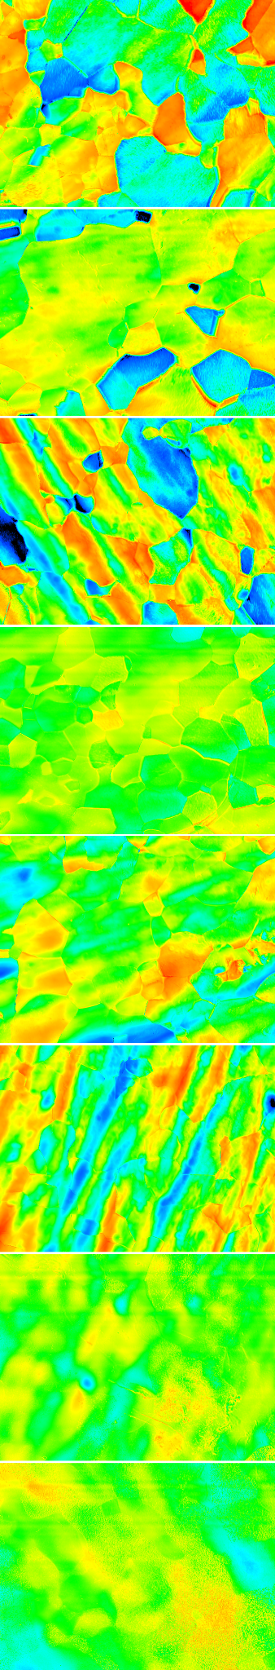
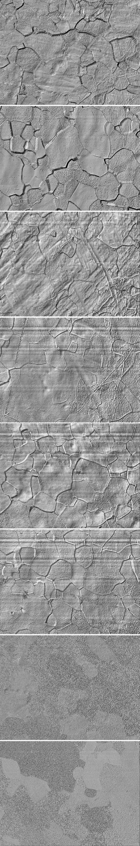
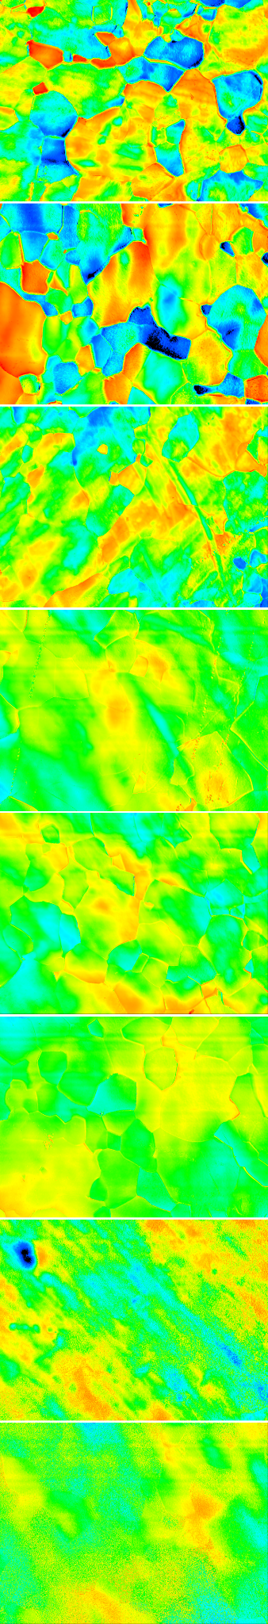
Surface Analysis of Electropolished Samples
The sample study showed that the etching was caused by low polishing voltage.
Nitrogen doping shows no effect on etching.
Temperature has no direct impact but can cause an ohmic voltage drop in the electrolyte due to high currents.
Cathode was redesigned and voltage increased to prevent etching in cavities.
Voltage
0.5
0.6
0.7
0.8
0.9
1.0
1.1
1.2
Voltage
0.5
0.6
0.7
0.8
0.9
1.0
1.1
1.2
Undoped
Undoped
Nitrogen Doped
Nitrogen Doped
Nitrogen Doped Cold EP
Nitrogen Doped Cold EP

Slide 6
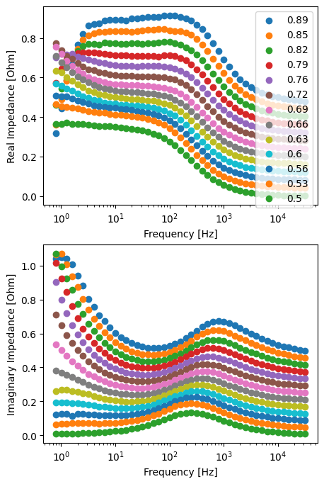
Electrochemical Impedance Spectroscopy
To understand the cause of etching in cavities, electrochemical impedance spectroscopy (EIS) can provide more information on the chemical processes on the electrode surface.
A small alternating voltage is applied to the electrode to measure the complex electrical impedance spectrum.
This spectrum can show how the surface chemistry changes for different applied voltages.
The real (top) and imaginary (bottom) components of the complex electrical impedance of a niobium electrode during room temperature electropolishing at applied voltages ranging from 0.5 to 0.9 volts.

Slide 7
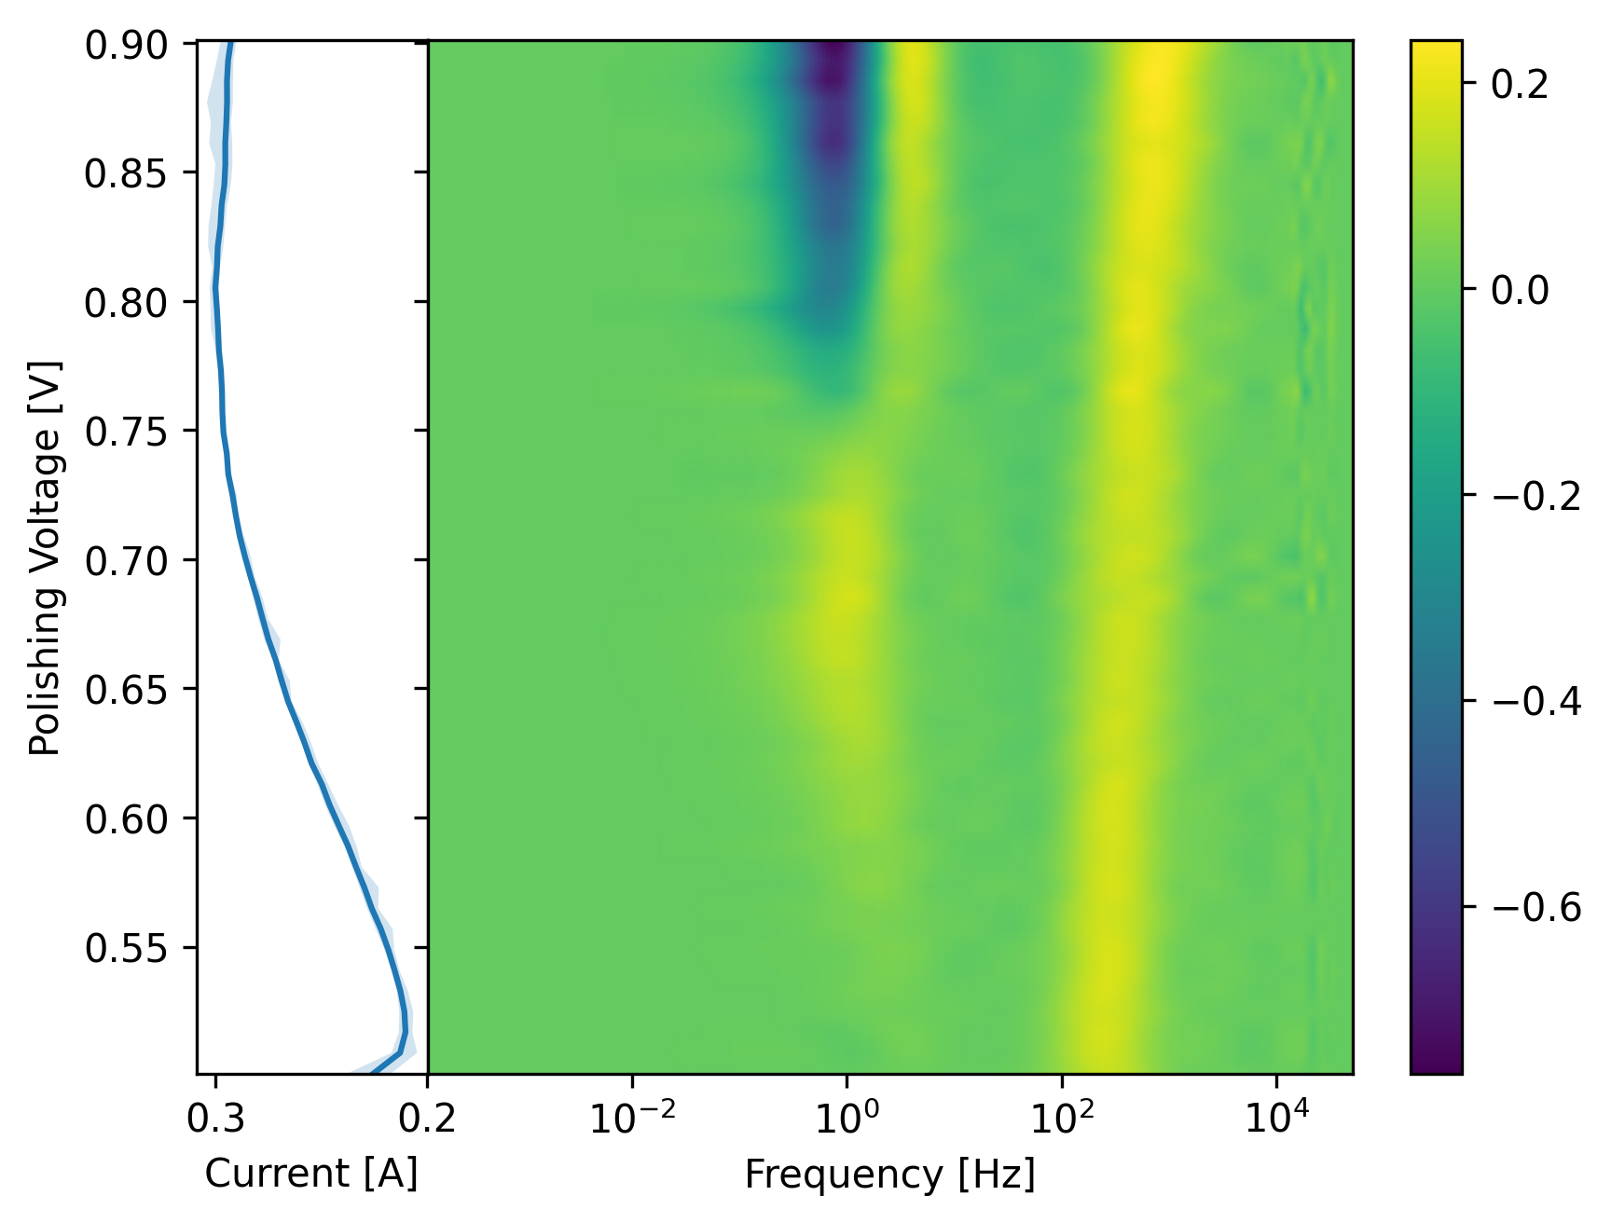
Data Analysis Using Distribution of Relaxation Times Fitting
The distribution of relaxation times de-convolves the impedance spectrum revealing distinct peaks that correspond to chemical processes.
At low voltage only the electric double layer contributes to the impedance.
As the voltage is increased a second contribution from the oxide film is measured.
The oxide film contribution develops further indicating the transition from a thin partial oxide layer to a thick oxide layer.

Slide 8
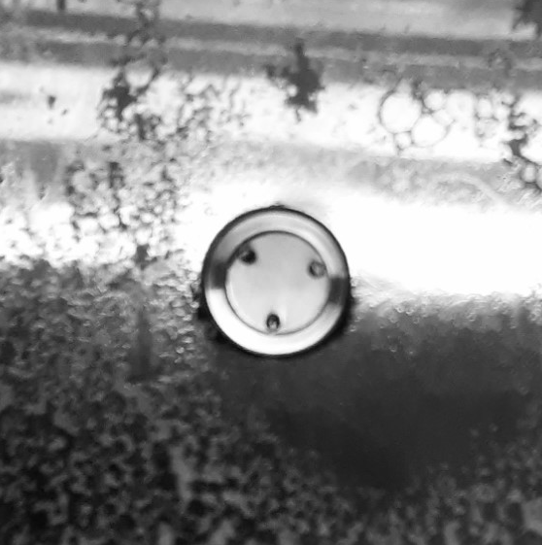
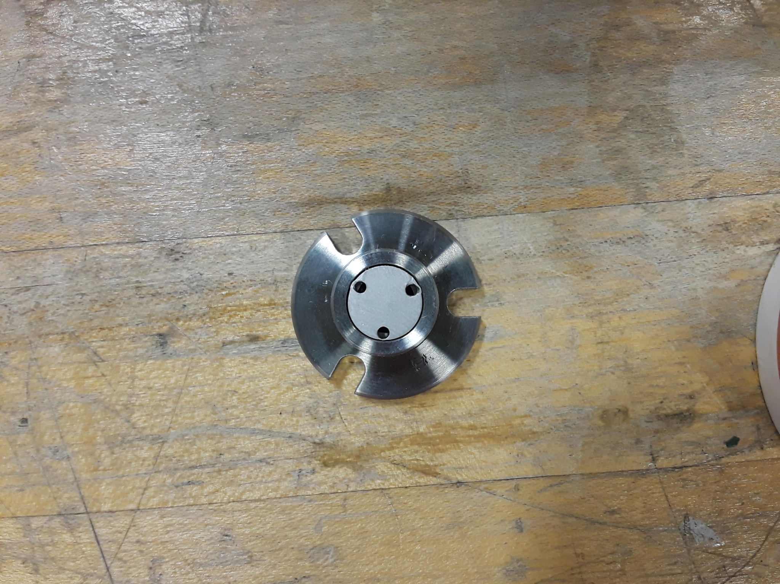
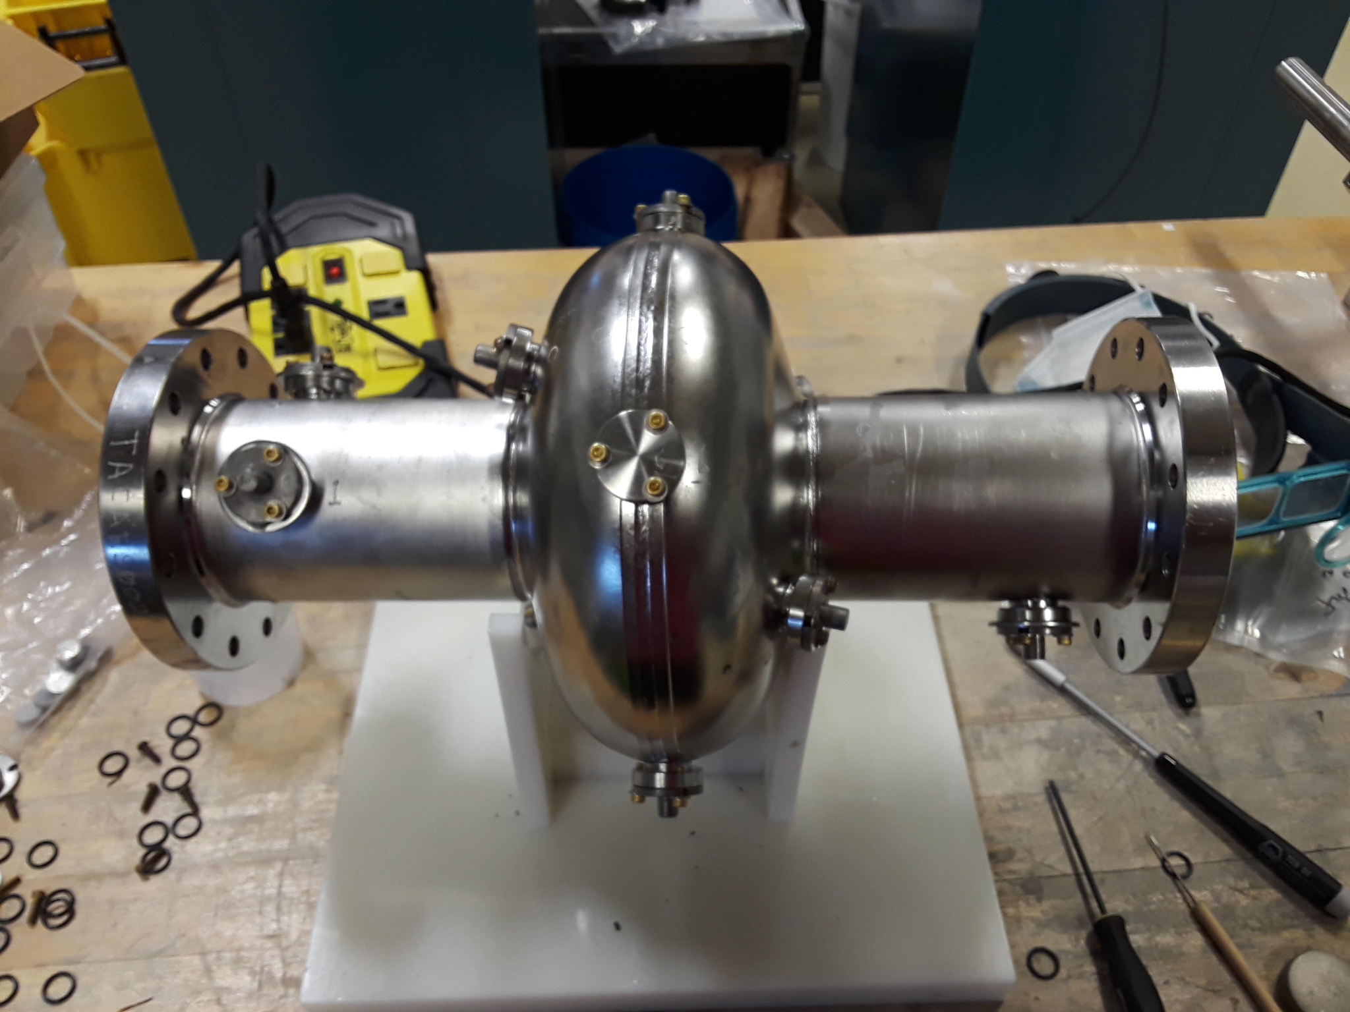
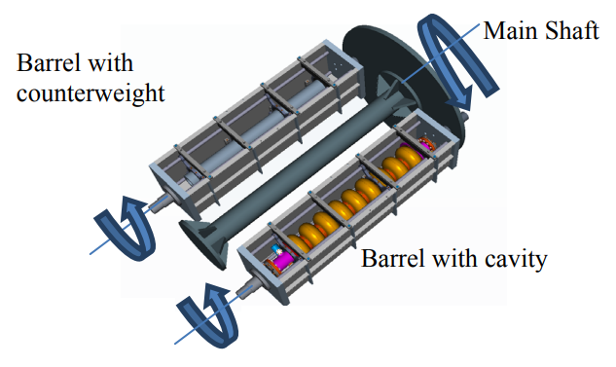
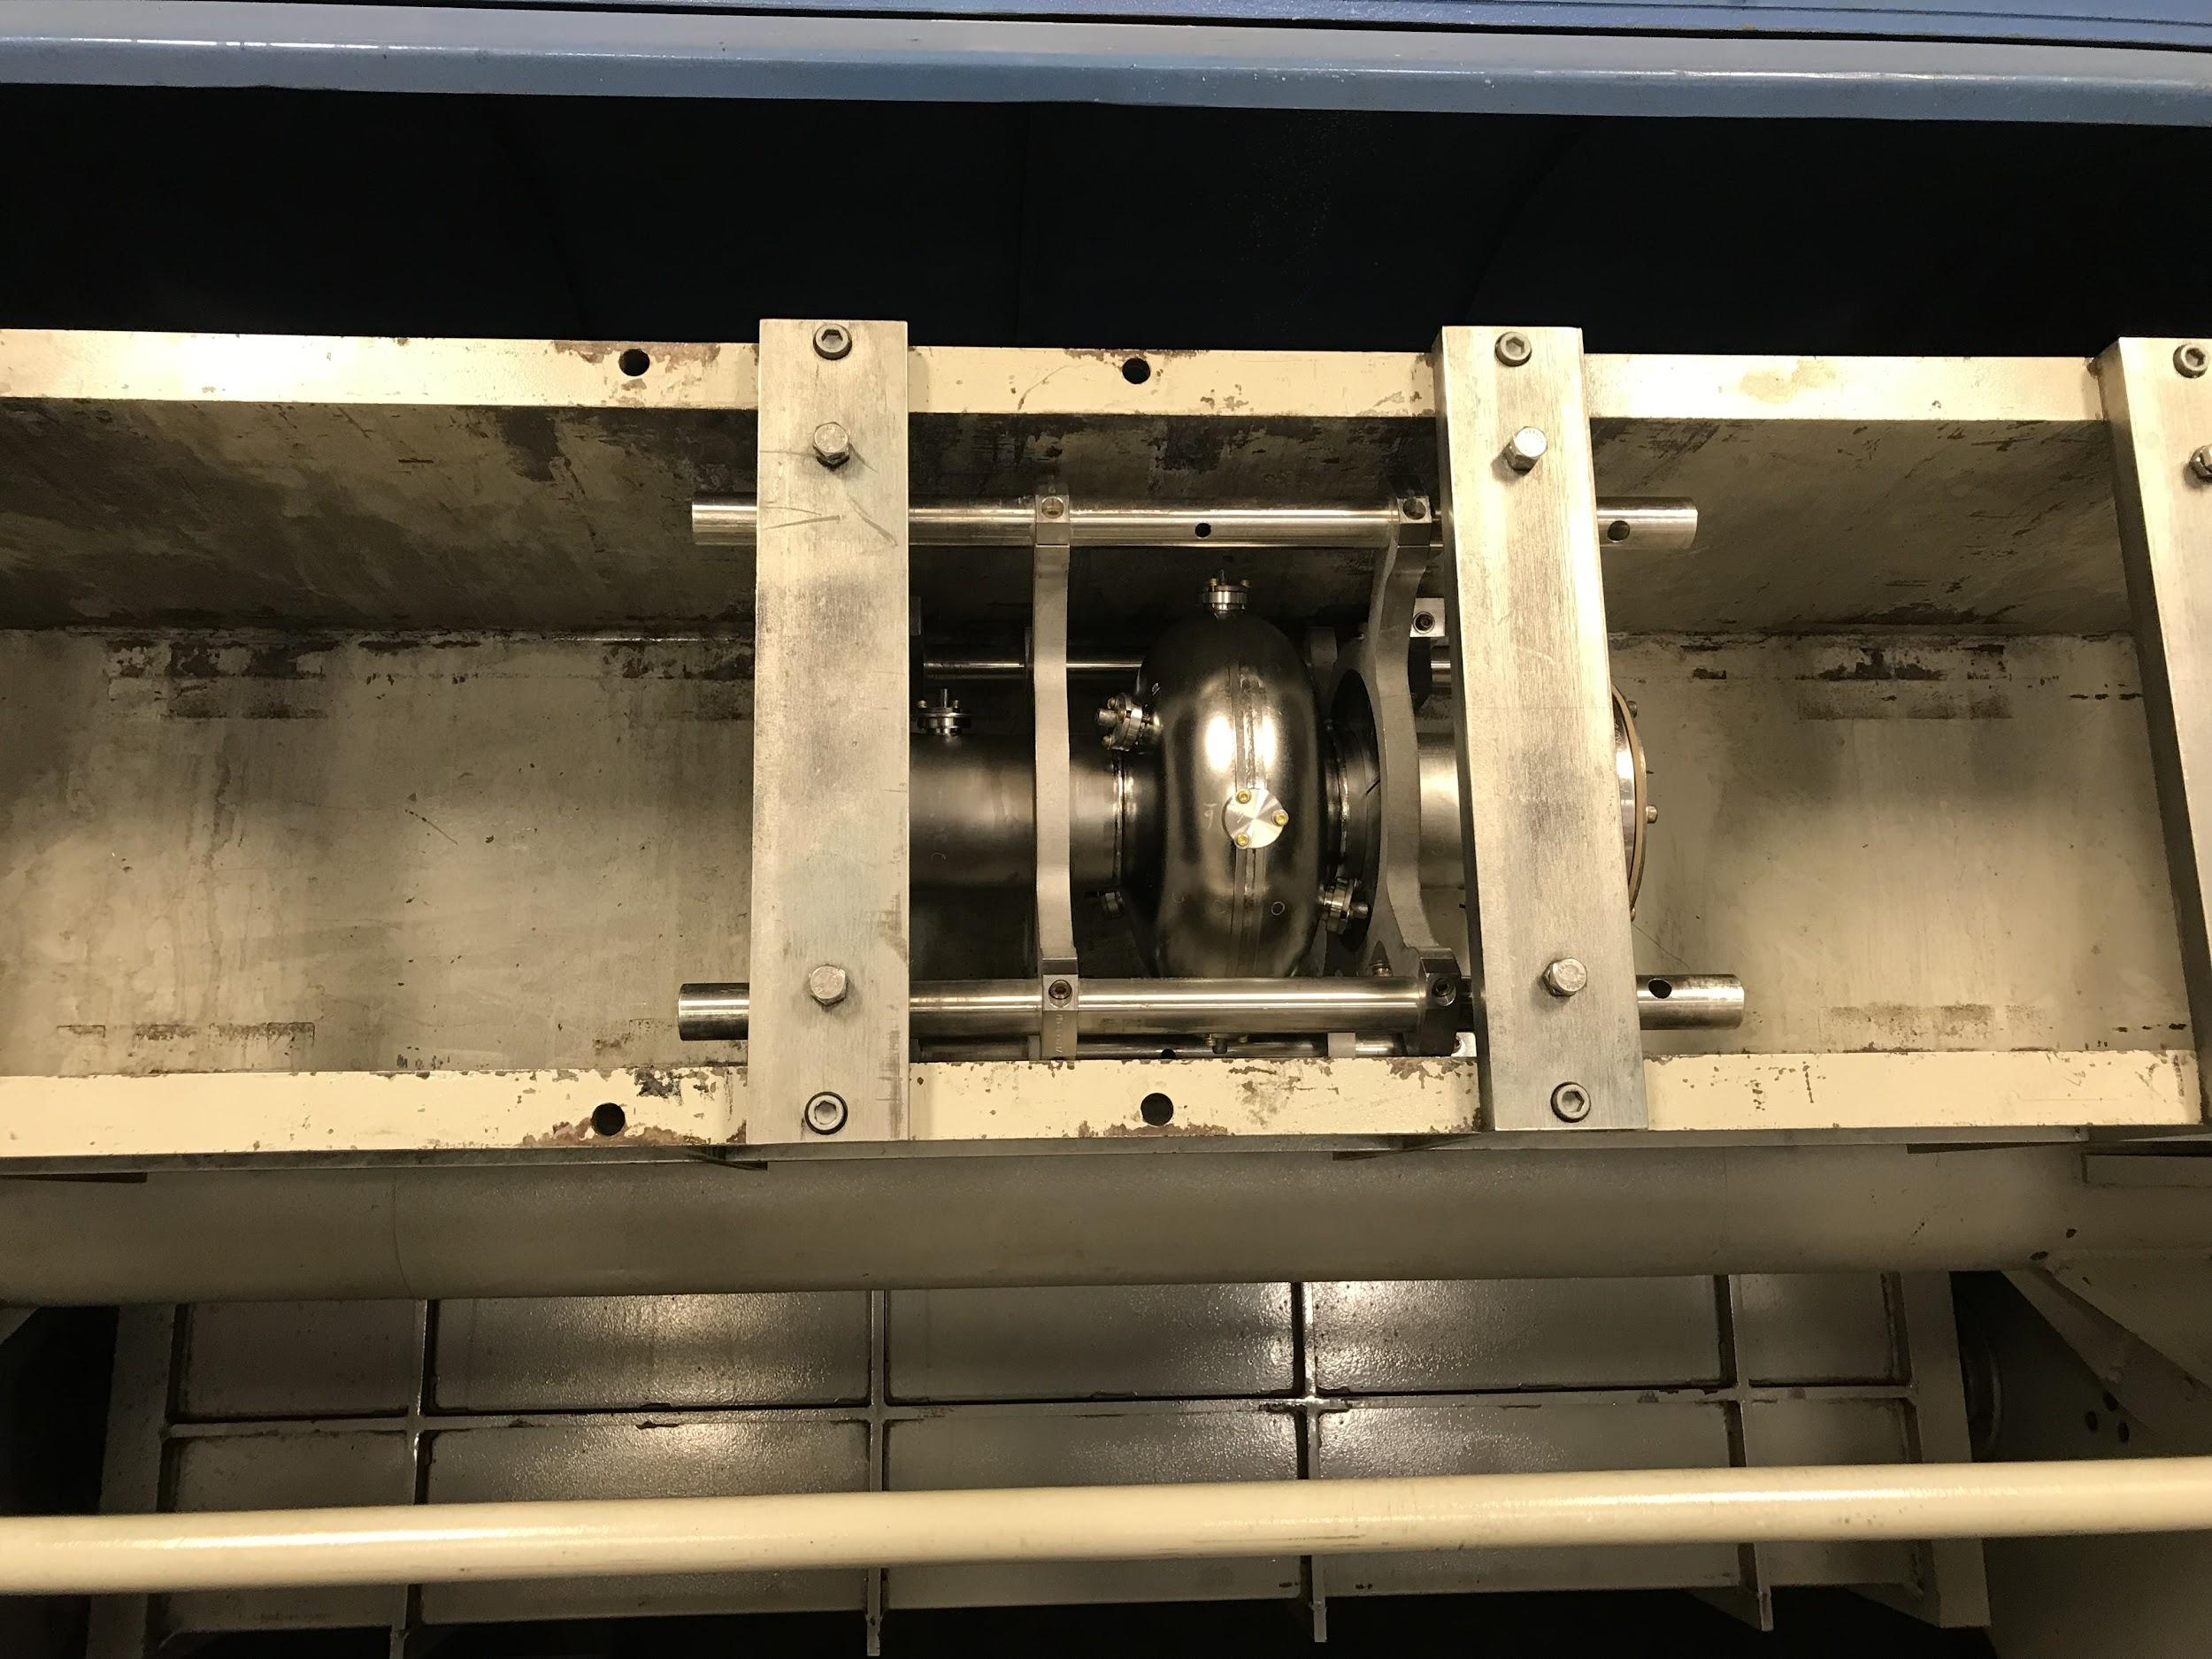
Nb₃Sn Polishing Using Centrifugal Barrel Polishing
Internal View
Nb₃Sn films have a rough surface that can enhance magnetic fields and reduce cavity performance.
Chemical polishing methods are not suitable.
Mechanical polishing was analyzed as an alternative using a coupon cavity sample study.

Slide 9
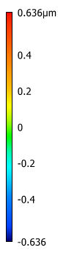
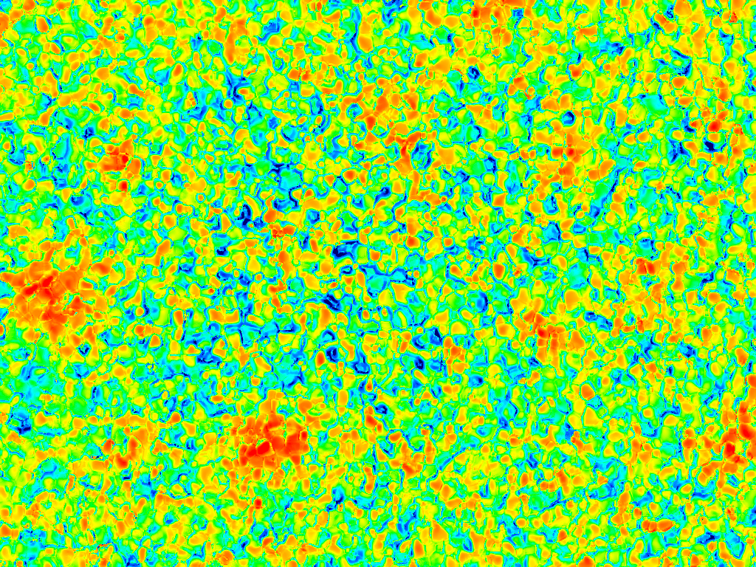
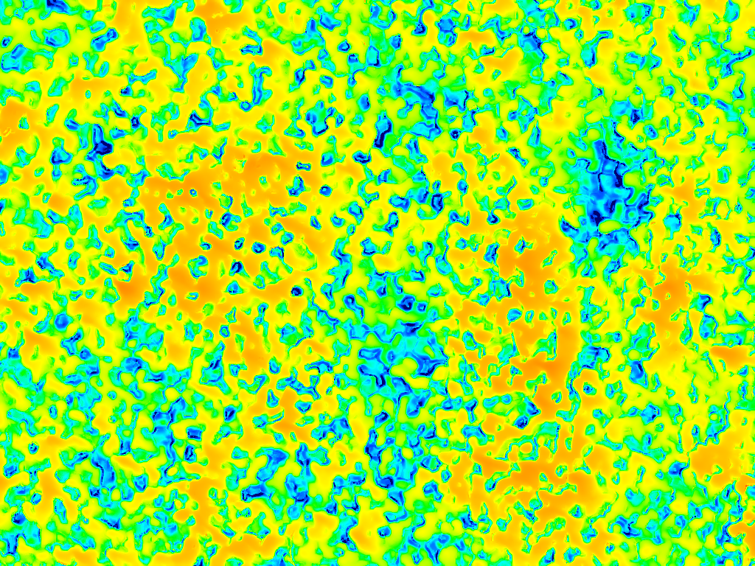
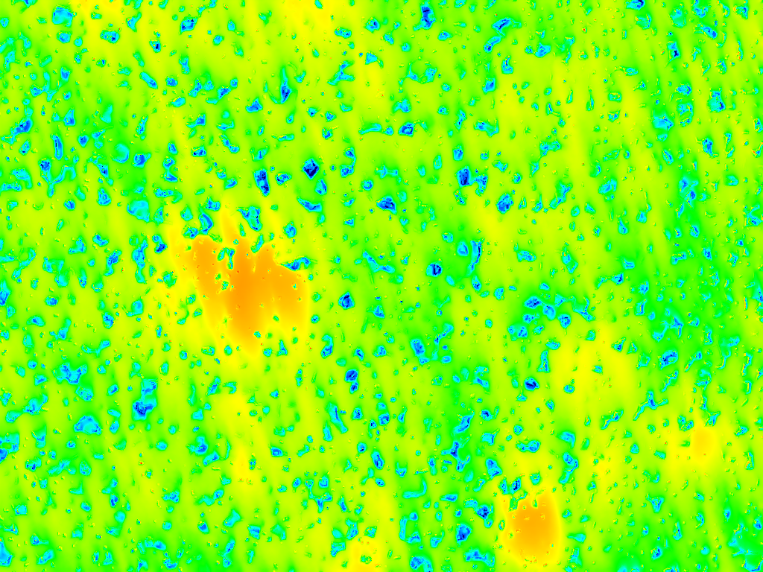
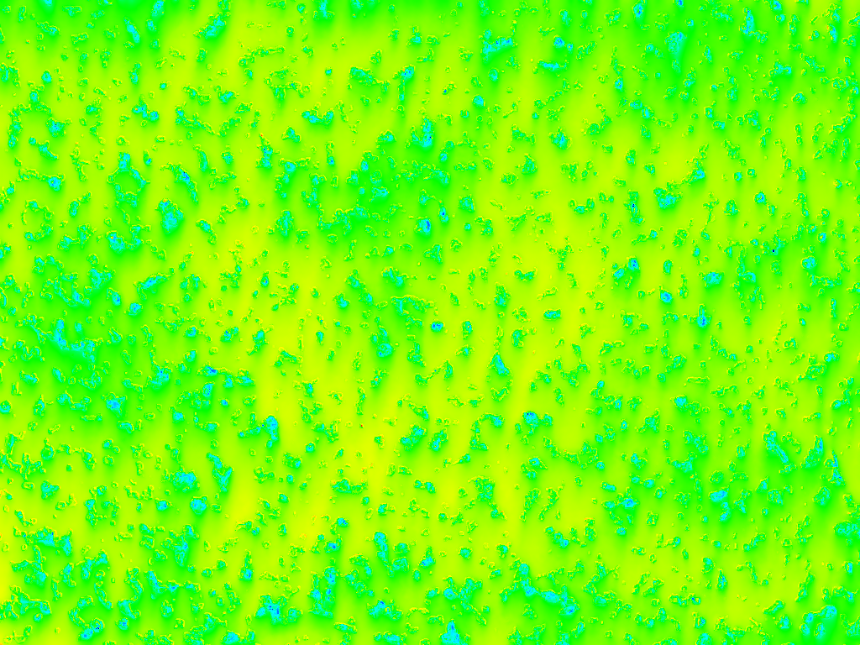
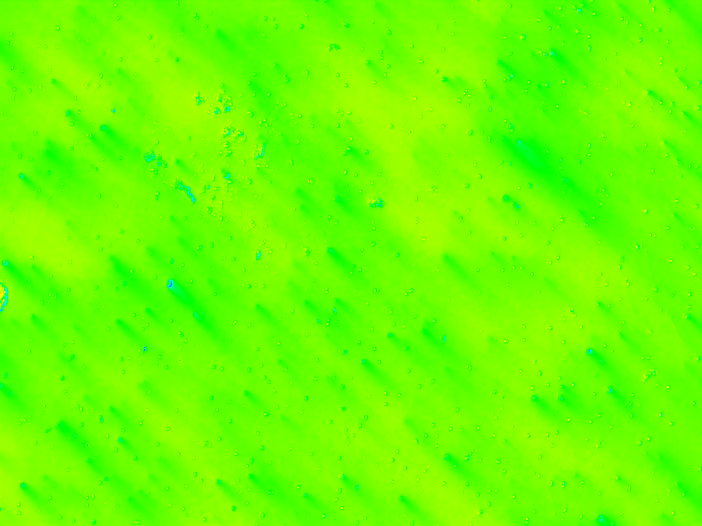
Surface Profile after Progressing Amounts of Mechanical Polishing
0 hours
2 hours
4 hours
6 hours
8 hours
86 μm

Slide 10
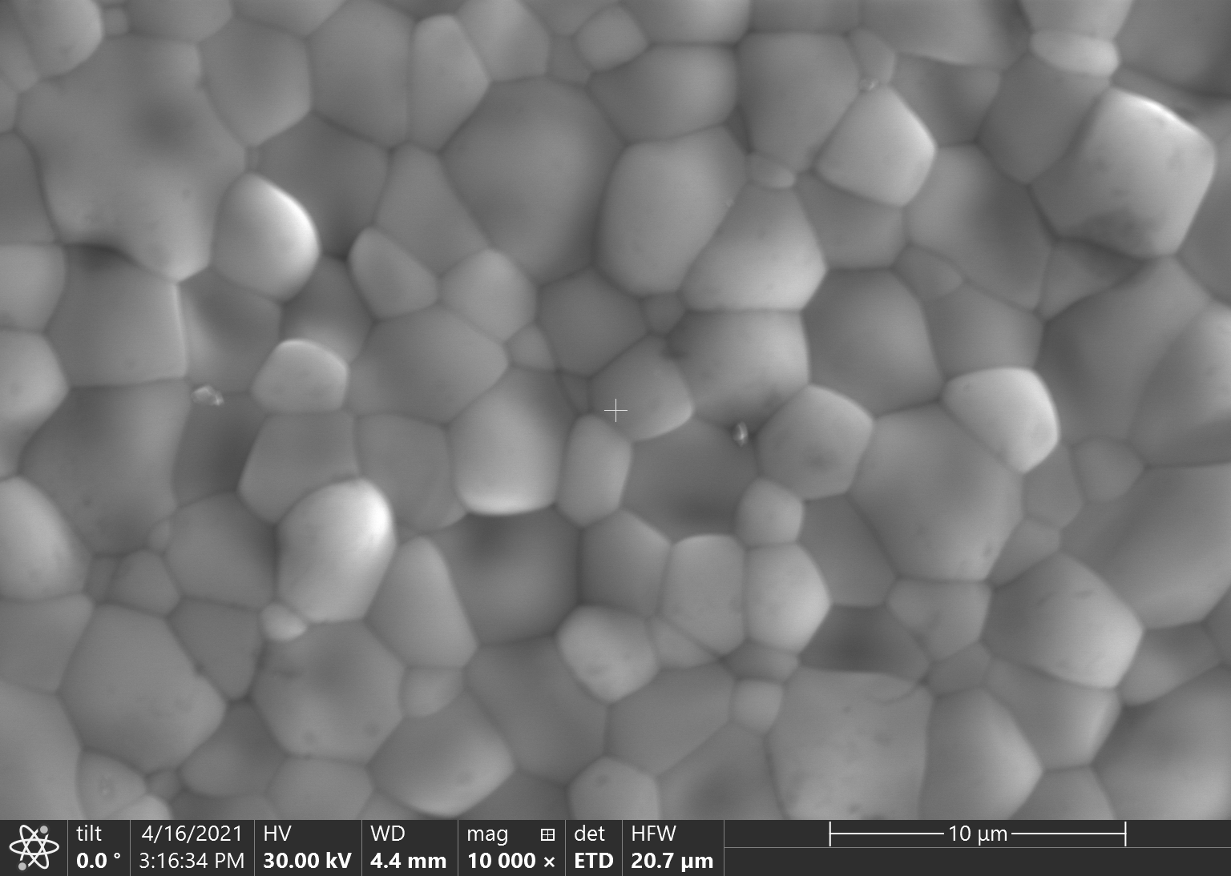
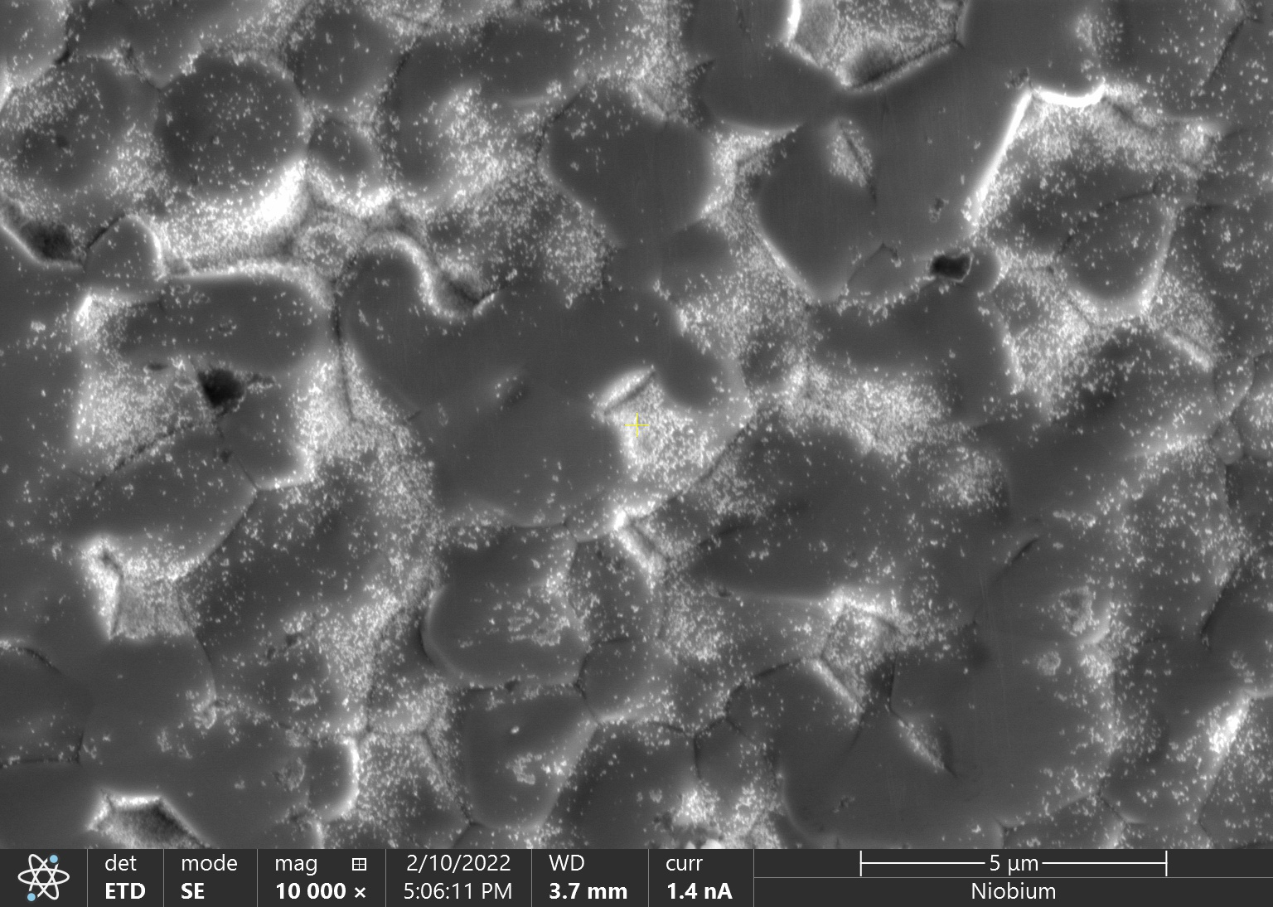
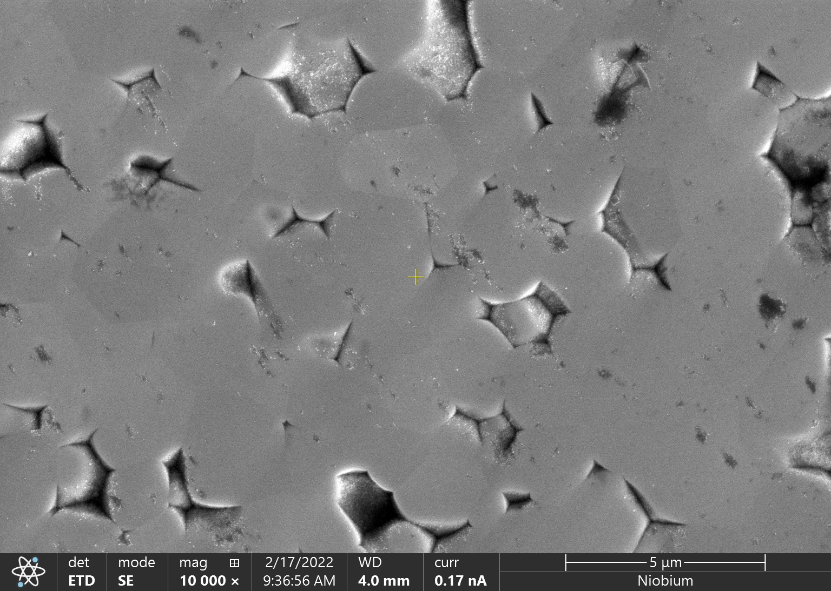
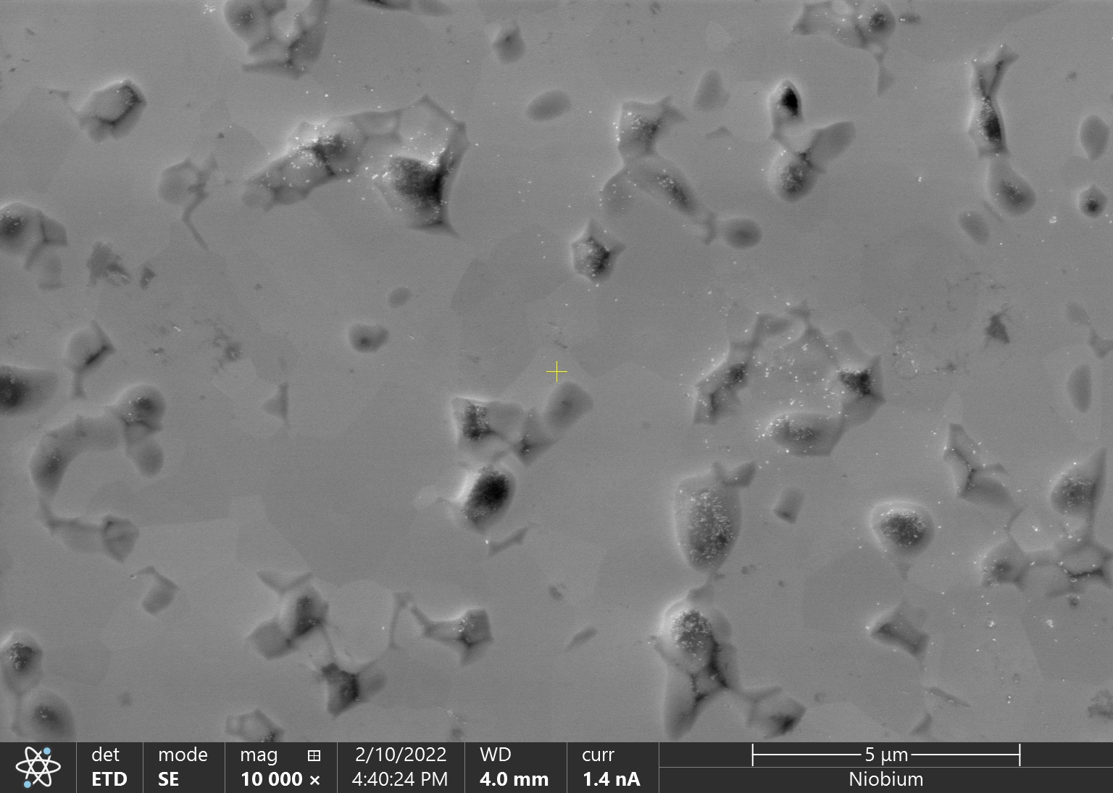
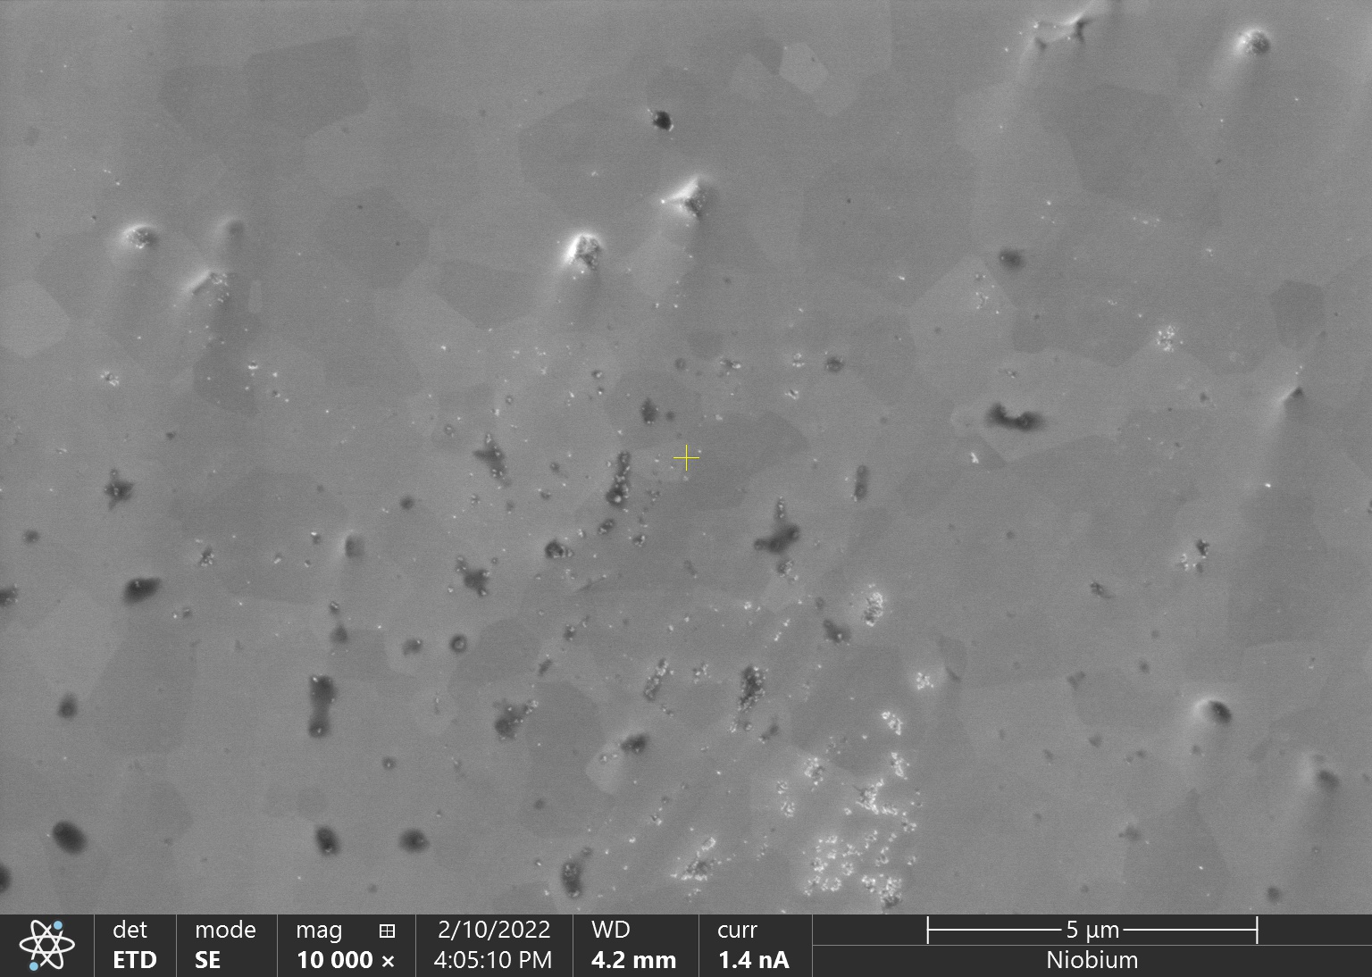
Scanning Electron Microscopy of Mechanically Polished Nb₃Sn Films
Initial Surface
2 hours
5 μm
5 μm
4 hours
6 hours
8 hours
5 μm
5 μm
5 μm

Slide 11
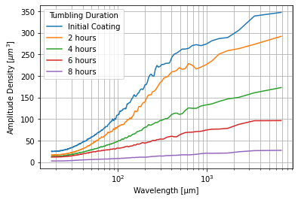
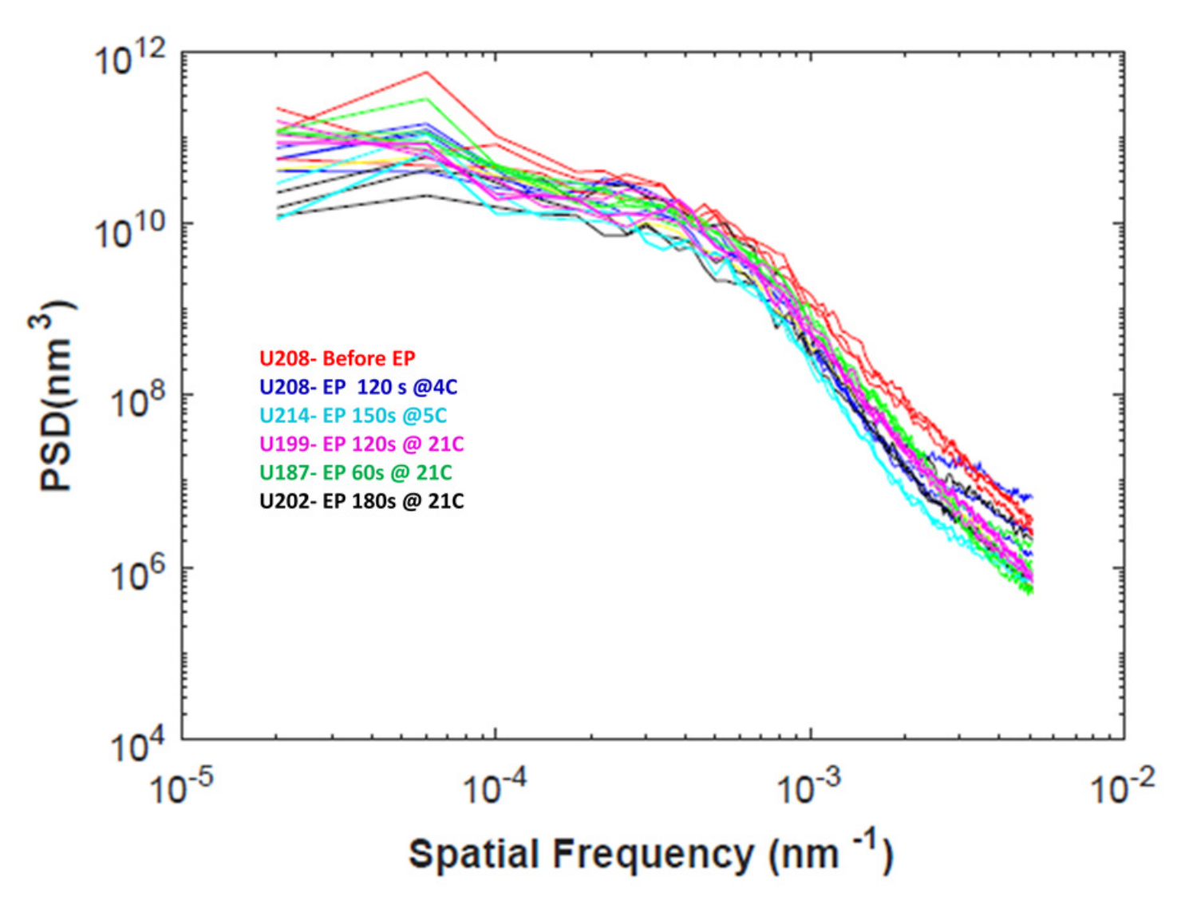
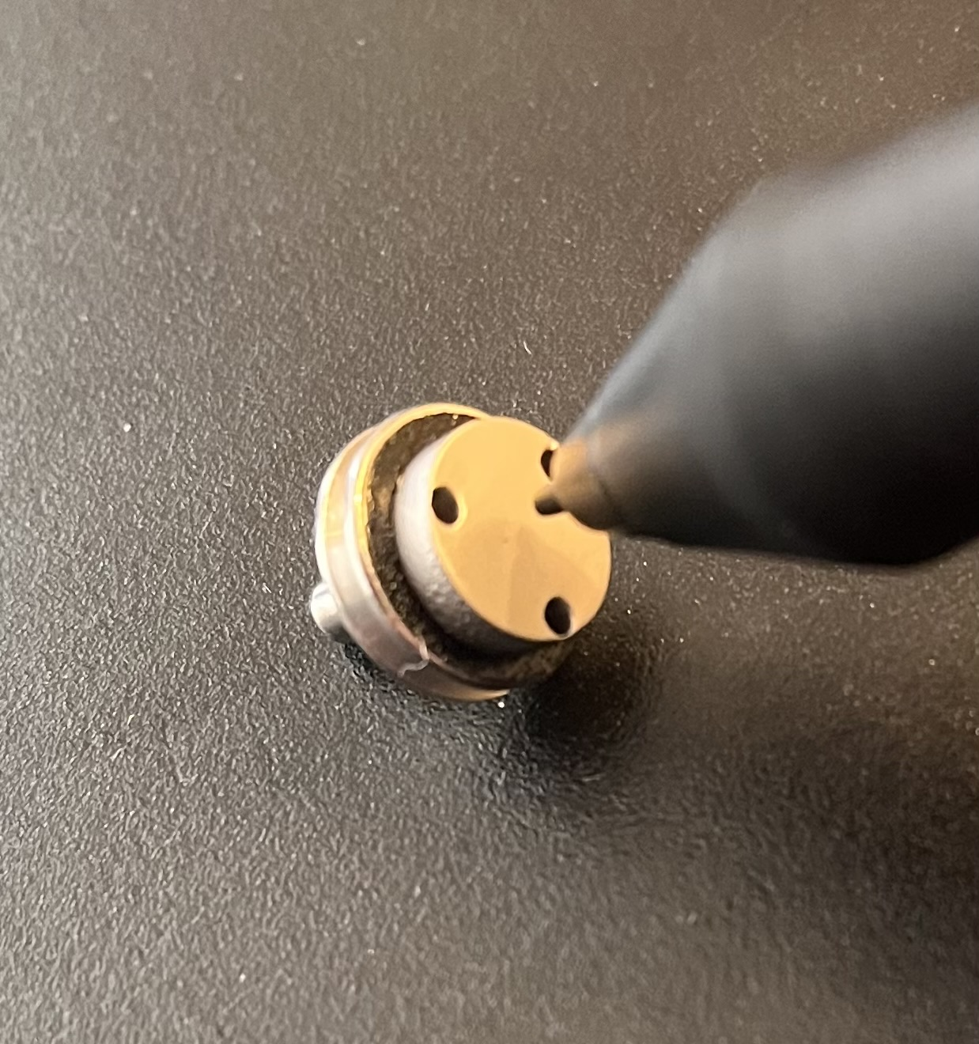
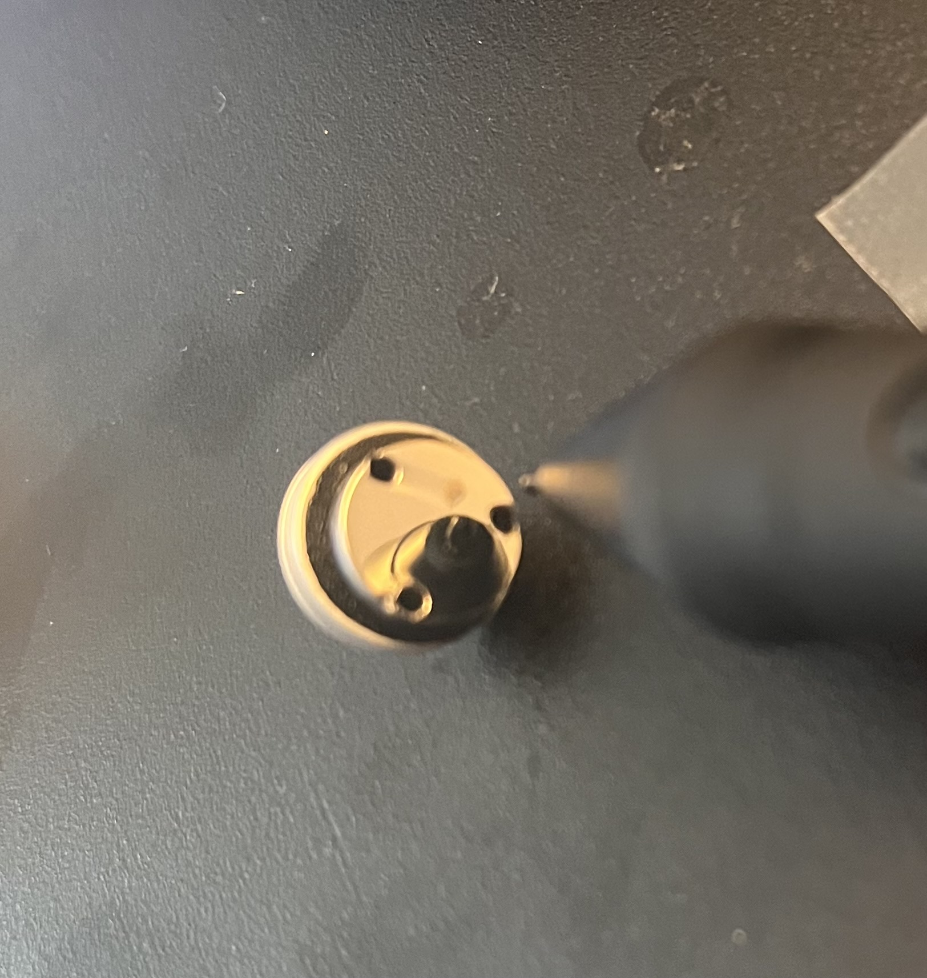
Surface Roughness of Mechanically Polished Nb₃Sn Films
Mirror-like surface finish
10x reduction in surface roughness after 8 hours of tumbling
Mechanical Polishing
Electropolishing
As-coated Nb₃Sn
Nb₃Sn after polishing
Pudasaini, Uttar, et al. Proceedings of the 18th International Conference on RF Superconductivity,(Lanzhou, China). 2017.

Slide 12
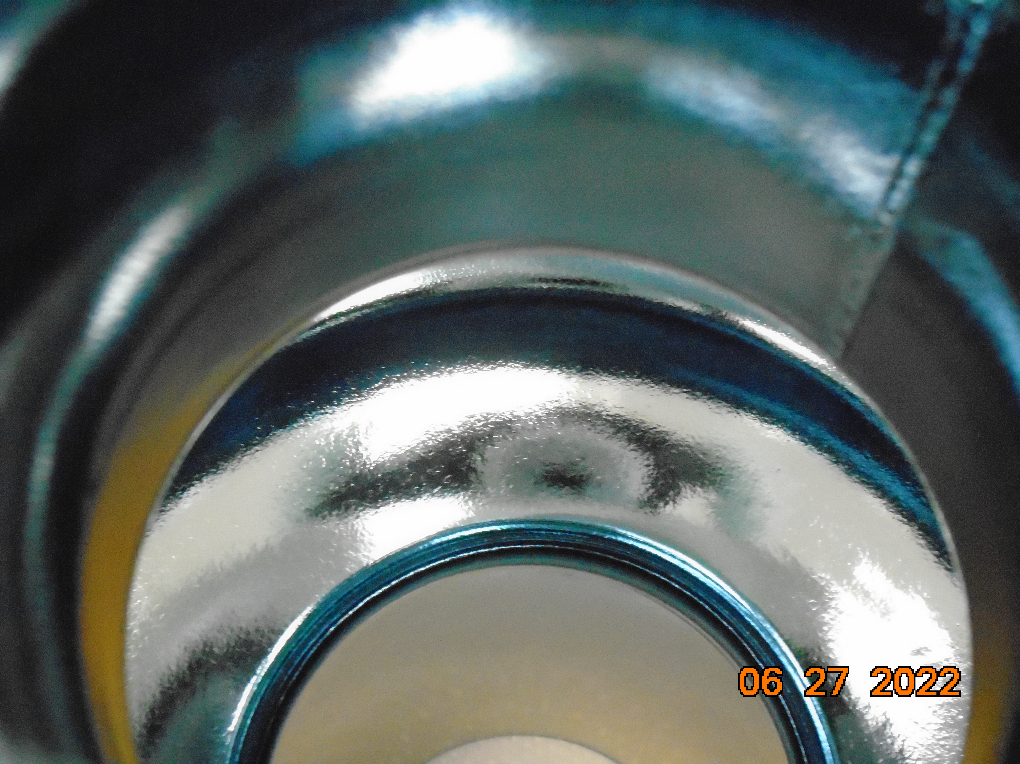
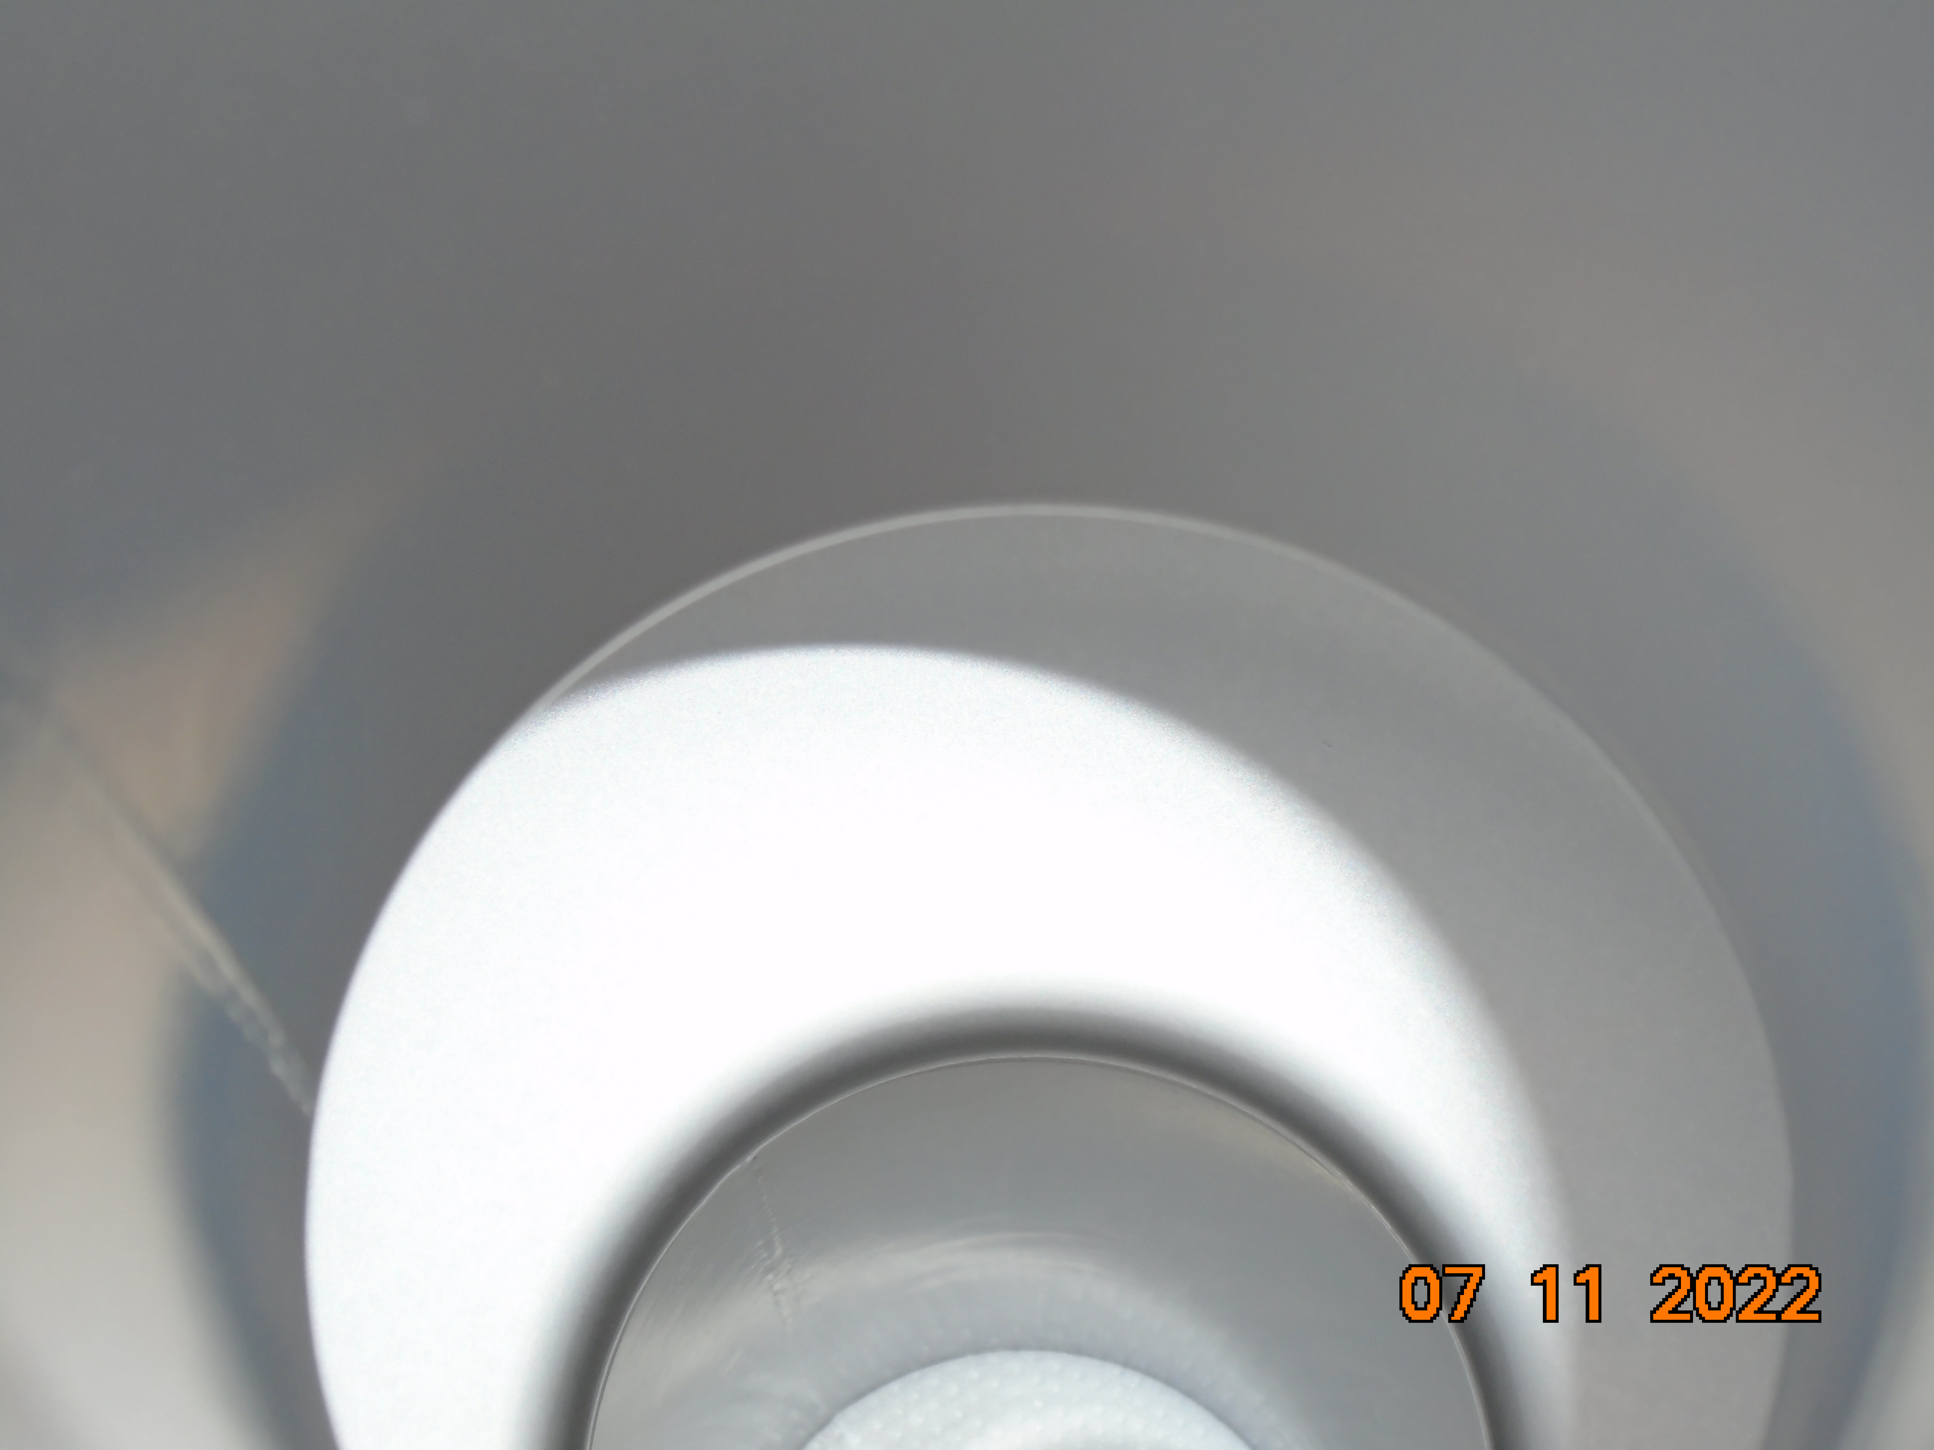
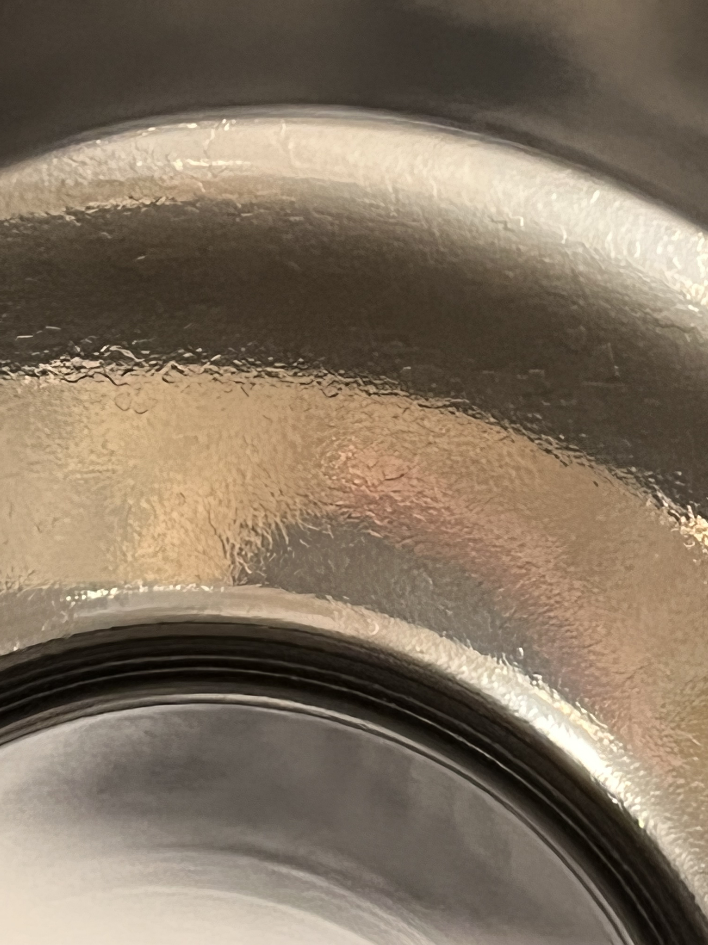
Applying the Polishing Procedure to a Nb₃Sn SRF Cavity
Mechanical polishing was tested on a Nb3Sn-coated single cell 1.3GHz cavity
4 hours of centrifugal barrel polishing
30 minutes of cleaning in an ultrasonic cleaner
Rinsed with a high-pressure (100 bars) water jet
Before Coating
After Coating
After Polishing

Slide 13
Performance of a Mechanically Polished Nb₃Sn SRF Cavity
Cavity performance was degraded after CBP.
A recoating was applied to the cavity to repair the damage.
After recoating, performance was significantly improved over the unpolished cavity.
Typical Nb Q at 4K

Slide 14
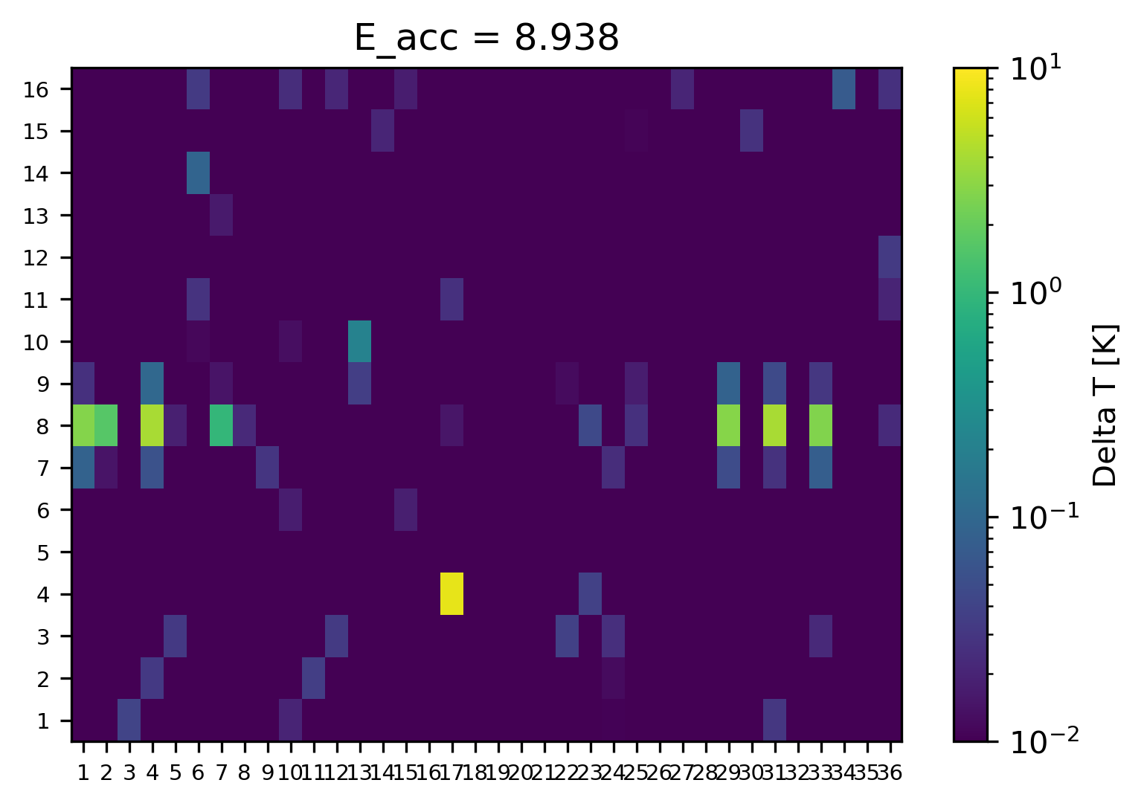
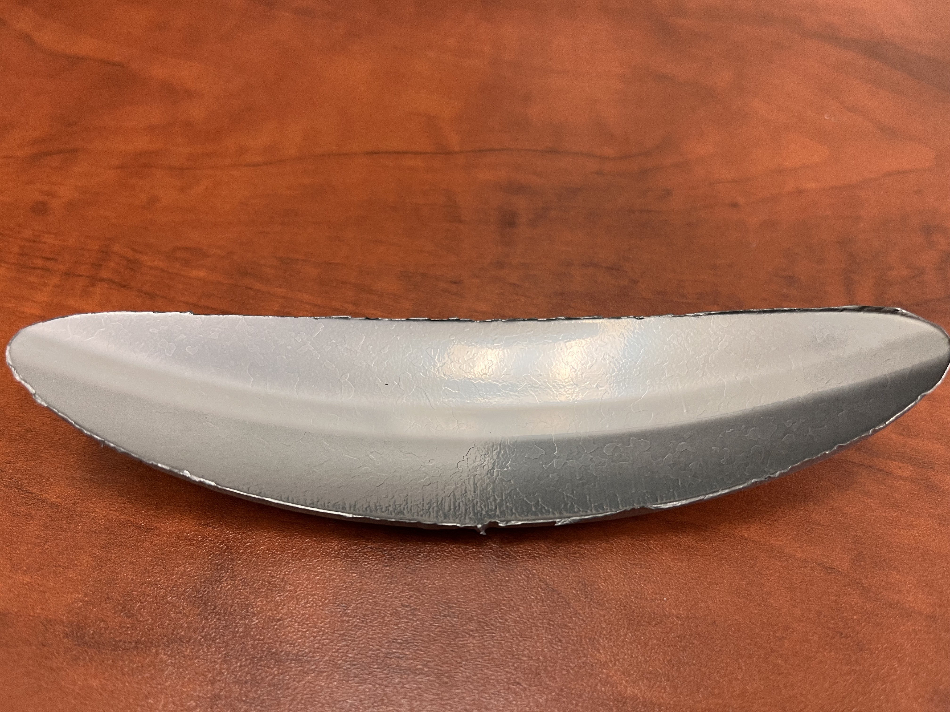
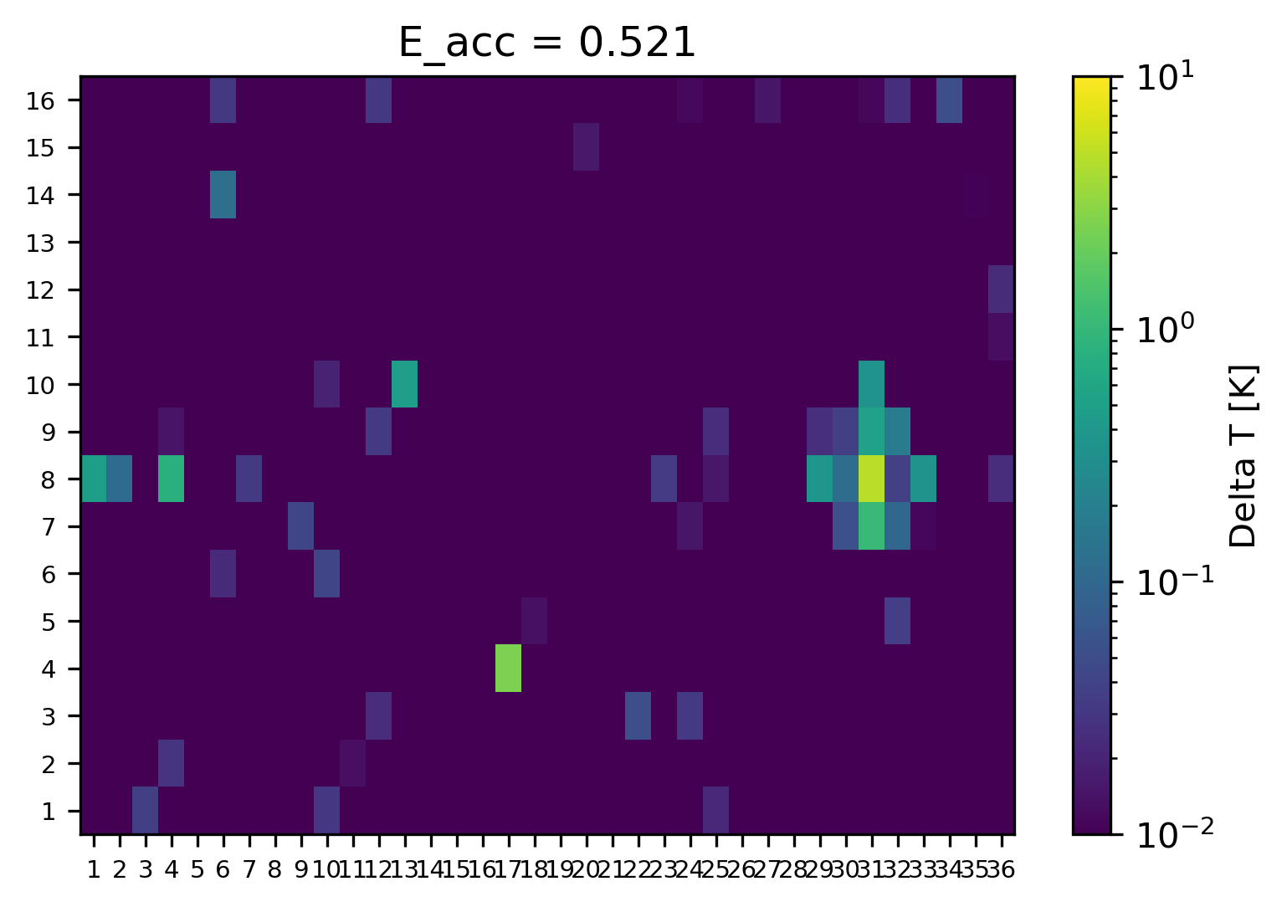
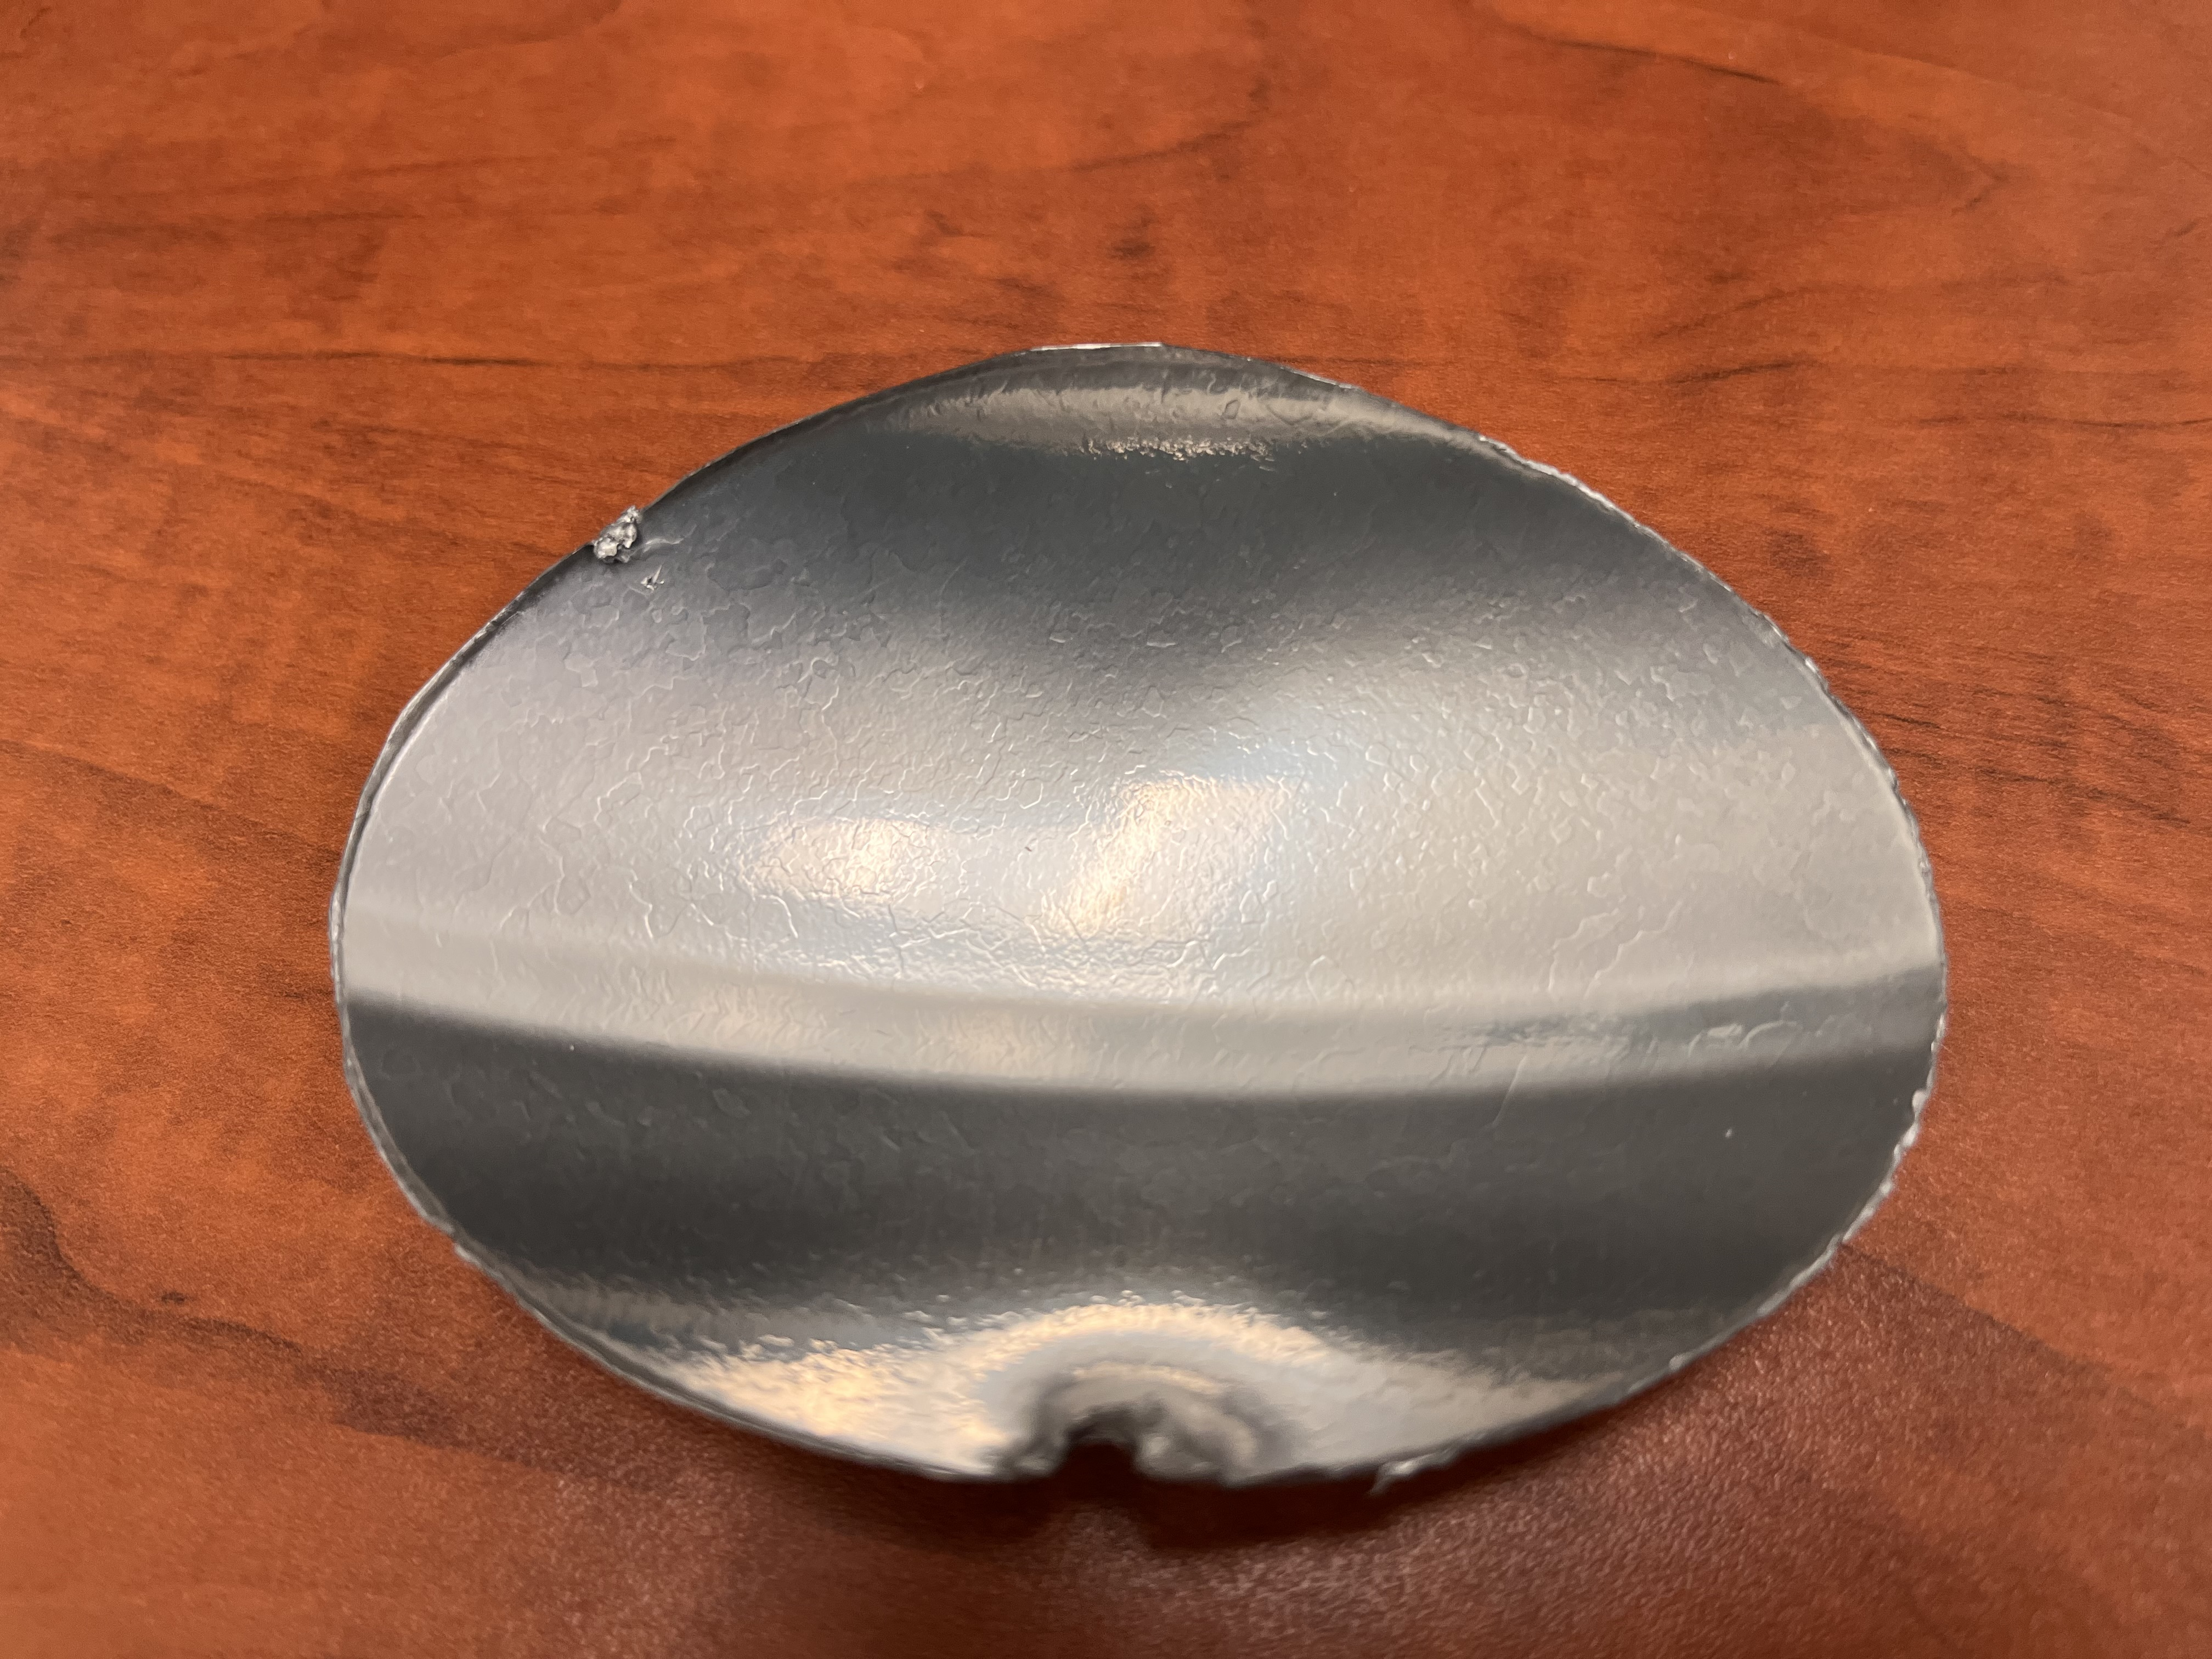
Temperature Mapping and Sample Cutout Study
The temperature distribution over the surface of the cavity was measured using an array of sensors.
Two potential quench locations can be seen.
The hot spots were cut from the cavity and analyzed to determine the quench mechanism.
Several cold spots were cut from the cavity to compare.

Slide 15
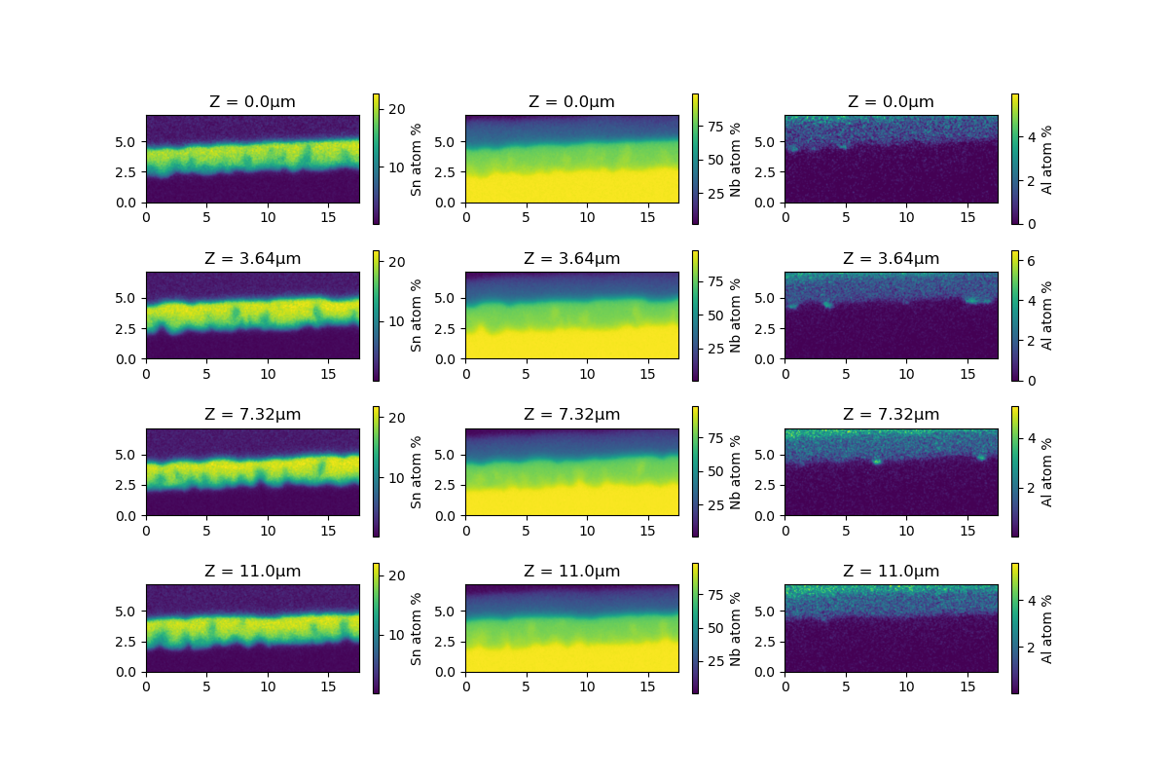
Cross-Section EDS Analysis of Cutouts
Pt Cap
Y
Nb₃Sn
Bulk Nb
Z
The Composition of the film is measured using EDS in 3D by a FIB-SEM instrument.
The film contains many Sn deficient regions especially near the Nb₃Sn-Nb interface.
Aluminum-oxide particles can be seen on the surface of the film.
X

Slide 16
Research Proposal:
SRF Cavity Manufacturing Cost Reduction
Eric Viklund

Slide 17
Overview
Niobium SRF cavities contribute significantly to the overall cost of the cryomodule
Each 9-cell niobium cavity costs ~$100,000
Additional treatments further increase costs
Surface polishing
Doping and heat treatments
To reach the ~900 cryomodules required for the ILC, costs must be reduced
Two cost saving technologies:
Large grain SRF cavity fabrication
HF-free electropolishing

Slide 18
Study on Deformation and Annealing Properties of Large Grain Niobium
Large grain niobium is an attractive material for SRF cavities due to lower cost compared to fine grain niobium.
Disks are cut directly from ingot
No forging and annealing of the niobium sheet required
Lower material waste generated, 15% compared to 45%¹
Fabrication is more difficult compared to fine grain niobium
Anisotropic material properties
Weakness at grain boundaries
To improve the large grain cavity fabrication process, I will study the annealing and deformation properties of large grain niobium.
1. Kneisel, P., et al. Nuclear Instruments and Methods in Physics Research Section A: Accelerators, Spectrometers, Detectors and Associated Equipment 774 (2015): 133-150.

Slide 19
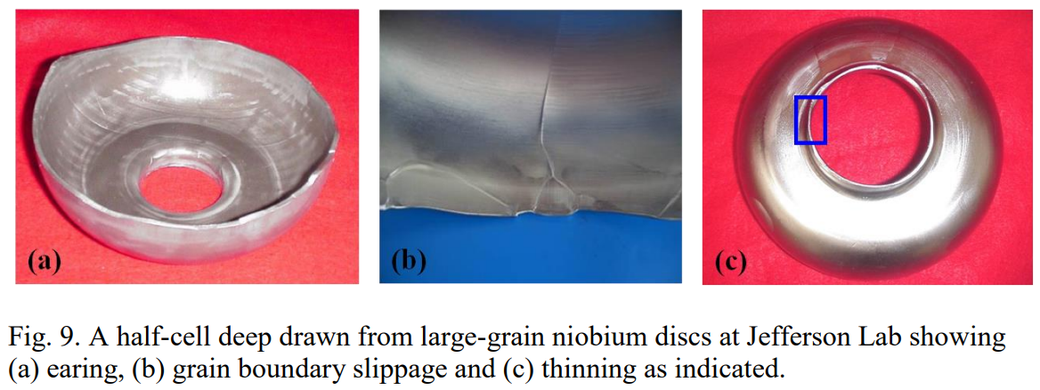
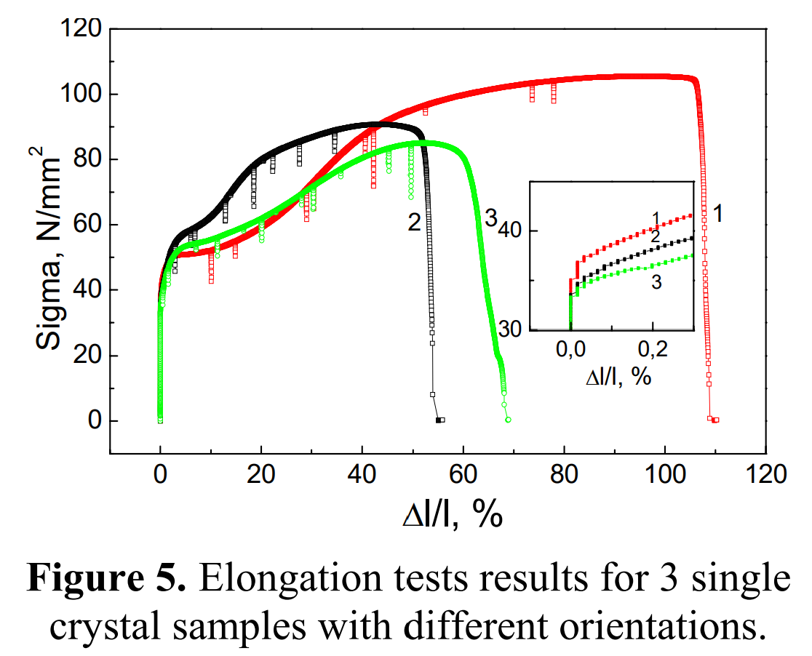
Current Issues with Large Grain Niobium Cavity Fabrication
Manufacturing defects are more common in LG cavities due to anisotropic material properties.
Oval shaped cavities
Grain boundary slippage
Non-uniform thickness
These defects compromise the cavity structural integrity and dimensional accuracy.
1. Kneisel, P., et al. Nuclear Instruments and Methods in Physics Research Section A: Accelerators, Spectrometers, Detectors and Associated Equipment 774 (2015): 133-150.

Slide 20
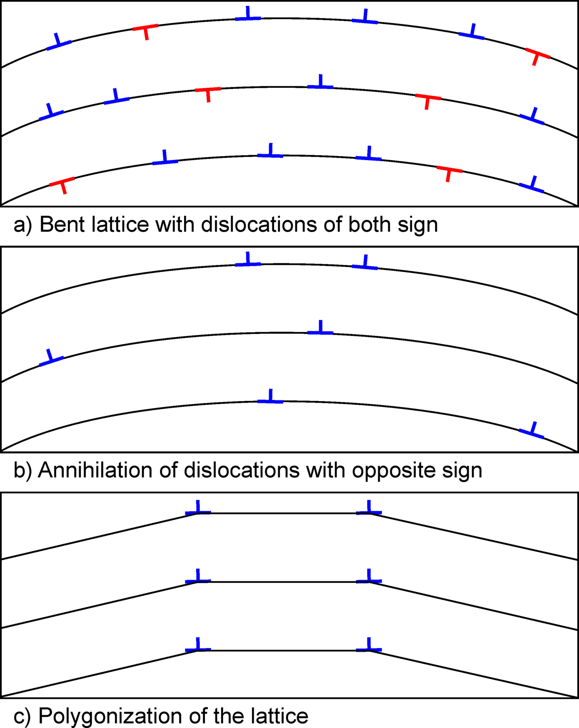
Annealing
https://en.wikipedia.org/wiki/Recovery_(metallurgy)
Annealing the niobium increases the ductility of the material by allowing for dislocation motion.
Ductility is improved through two processes:
Grain nucleation
Recovery
Intermediate annealing already used for cavity fabrication with hydroforming to improve the ductility of fine grain niobium.¹
By introducing an annealing step during the deep drawing of the cavity, the manufacturing defects could be reduced or eliminated.
1. Yamanaka, Masashi, et al. THPB041,(these proceedings), SRF2015, Whistler, Canada (2015).

Slide 21
Plan of Study
Mechanical property study using large grain test samples.
Anisotropic mechanical properties
Grain boundary properties
Study annealing properties in sample using furnace.
Recrystallization and recovery
Ductility
Model behavior of large grain niobium during cavity drawing using computational modelling.
Apply findings to large grain cavity fabrication process.
This study will utilize the press forming and high temperature furnace capabilities of KEK’s Cavity Fabrication Facility.

Slide 22
HF-Free Bipolar Electropolishing
The use of HF in the fabrication of niobium SRF cavities provides a challenge for the large-scale production of cavities.
Environmental impact of large volumes of toxic chemicals used.
Human safety risk of working with toxic chemicals.
Increased costs due to strict safety requirements and procedures.
Cost estimates for electropolishing with HF is $2,934 per cavity.¹
Bipolar electropolishing is a new technique for polishing niobium without using HF acid.
Material removal is achieved by alternating the polarity of the niobium.
Anodic oxidation pulse
Cathodic dissolution of the oxide
Bipolar electropolishing can utilize HF-free electrolytes or even neutral salt-based electrolytes.
1. Taylor, E. J., et al. SRF2015, Whistler, BC, Canada (2015): 359.

Slide 23
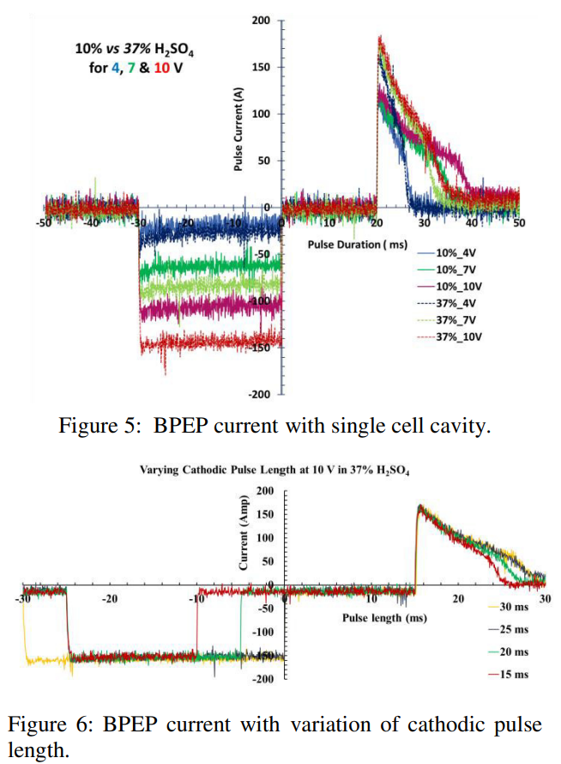
Bipolar Electropolishing Study
Bipolar EP has been shown to be effective by Faraday Technology, Inc., Cornell SRF group, KEK, and Jefferson Lab.
To integrate bipolar electropolishing in large-scale cavity fabrication for the ILC the removal rate must be improved.
120 hours to remove 64 μm¹
Removal rates are currently limited by the power supply.
High currents during voltage pulse
Electrolysis during cathodic pulse
Limited repetition rate
F. Furuta et al., in Proc. 18th Int. Conf. on RF Superconductivity (SRF'17), Lanzhou, China, July 2017, paper TUPB074, pp. 567-570, ISBN: 978-3-95450-191-5, https://doi.org/10.18429/JACoW-SRF2017-TUPB074, 2018.
Tian, Hui, et al. No. JLAB-ACC-18-2836; DOE/OR/23177-4574; TUPO043. Thomas Jefferson National Accelerator Facility (TJNAF), Newport News, VA (United States), 2019.

Slide 24
Plan of Study
Optimize bipolar EP parameters through a sample study
Optimize pulse waveform for high efficiency
Explore different electrolytes, neutral salt electrolytes
Electrochemical impedance spectroscopy will be used to analyze the electrochemical nature of the process to better determine the optimal pulse voltage and duration.
Utilize KEK’s vertical EP capabilities and develop high current pulsed power supply to perform bipolar EP on 1-cell and 9-cell cavities.

Slide 25
Questions

